Slide 1

Unit – 1 Descriptive Statistics
Probability & Statistics (PS)
DU # 2301HS402
Prof. Vasudev Barjadiya
Department of Humanities & Science
vasudev.barjadiya@darshan.ac.in
901 64 27 200

Slide 2

Topics of Unit 1
Introduction to Frequency Distributions
Measure of Central Tendency
Measure of Variability
Moments
Measures of Skewness
Kurtosis Based on Moments
Looping

Slide 3

Outline of Unit 1
Introduction to Frequency Distributions
Ungrouped Data
Grouped Data
Measure of Central Tendency
Mean
Median
Mode
Looping

Slide 4

Outline of Unit 1
Measure of Variability
Range
Standard Deviation
Mean Deviation
Moments
Moment About Mean
Moment About Assumed Mean
Moments About Zero
Looping

Slide 5

Looping
Outline of Unit 1
Measures of Skewness
Karl Pearson’s Method
Method of Moment
Kurtosis Based on Moments

Slide 6
Introduction
Statistics is the branch of science where we plan, gather and analyze information about a particular collection of objects under investigation.
Statistics techniques are used in every other field of science, engineering and humanity, ranging from computer science to industrial engineering to sociology and psychology.
For any statistical problem the initial information collection from the sample may look messy, and hence confusing. This initial information needs to be organized first before we make any sense out of it.

Slide 7
Introduction
There are two types of statistics :
(1) Descriptive Statistics ( Unit – $1$ )
(2) Inferential Statistics ( Unit –$4$& $5$)

Slide 8
Descriptive Statistics
A data set is a collection of observations from a sample or entire population. This data set is summarized and organized by Descriptive Statistics.

Slide 9
Descriptive Statistics
Descriptive Statistics
Distribution
Measure of central Tendency
Measure of Variability
Range
Ungrouped Distribution
Mean
Standard Deviation
Discrete Frequency Distribution
Median
Mean Deviation
Continuous Frequency
Distribution
Mode
Moments , Skewness and Kurtosis

Slide 10
Method 1 Frequency Distributions

Slide 11
Frequency Distribution
The distribution is a summary of the frequency of individual values or ranges of values for a variable.
Types of Frequency Distribution :
There are two types of frequency distribution which is
Frequency distribution of ungrouped data
Frequency distribution of grouped data

Slide 12
Frequency Distribution of Ungrouped Data
The ungrouped frequency distribution is a type of frequency distribution that displays the frequency of each individual data value.
For example:
Marks of $10$ students are$10, 25, 26, 35, 3, 8, 19, 29, 30, 18.$

Slide 13
Frequency Distribution of Grouped Data
Discrete Frequency Distribution
A discrete frequency distribution is a type of frequency distribution that shows each number and the number of times it appears in a list.
For example:
Data of students using library during exam time.
No. reading hours $\left(x_{i}\right)$ | $$1$$ | $$2$$ | $$3$$ | $$4$$ | $$5$$ | $$6$$
No. of students$\left(f_{i}\right)$ | $$4$$ | $$7$$ | $$8$$ | $$9$$ | $$10$$ | $$2$$

Slide 14
Frequency Distribution
Continuous Frequency Distribution
A continuous frequency distribution is a series in which the data are classified into different class intervals.
For example:
Data of students using library during exam time.
No. reading hours | $$0−2$$ | $$3−5$$ | $$6−8$$ | $$9−11$$
No. of students$\left(f_{i}\right)$ | $$11$$ | $$7$$ | $$8$$ | $$0$$

Slide 15
Class Intervals
Exclusive Class
If classes of frequency distributions are $0−2, 2−4, 4−6, …$such classes are known as exclusive classes.
Inclusive Class
If classes of frequency distributions are $0−2, 3−5, 6−8, …$ such classes are known as inclusive classes.

Slide 16
Class Intervals
Lower Boundary & Upper Boundary
For the class$x_{i}−x_{i+1}$,
lower boundary is$x_{i}$and upper boundary is$x_{i+1}$.
For example:
For the class $3−5$, lower boundary is $3$ and upper boundary is$5$.

Slide 17
Class Length
A difference between Upper boundary and Lower boundary is known as class length.
It is denoted by $c$ and defined as
$$c= Upper Boundary − Lower Boundary =x_{i+1}−x_{i}$$
For example:
For the class $3−5$, class length is
$5−3=2$.

Slide 18
Mid-Point of Class
Mid point of class is used to find $x_{i}$ in case of continuous frequency distribution.
It is defined as follow :
$$Mid point of class=x_{i}=\frac{Upper Boundary+ Lower Boundary}{2 }$$
For example:
For the class $3−5,$ mid point is
$$\frac{3+5}{2}=4.$$

Slide 19
Method 2 Measure of Central Tendency

Slide 20
Central Tendency
The central tendency of a distribution is an estimate of the center of a distribution of values.
There are three measures to estimate central tendency which is
Mean$\left( \overline{x} \right)$
Median $\left( M \right)$
Mode $( Z )$

Slide 21
Method 2.1 Mean

Slide 22
Mean
The mean means average.
Mean is denoted by “ $\overline{x}$ ” and read as x bar.
Table of different formulae of mean.

Slide 23
Mean
Method | Ungrouped Data | Discrete Grouped Data | Continuous Grouped Data
Direct Method
Assumed Mean Method
Step Deviation Method
$$\frac{\sum{x_{i}}}{n}$$
$$\frac{\sum{f_{i}x_{i}}}{\sum{f_{i}}}$$
$$A+\frac{\sum{d_{i}}}{n}$$
$$A+\frac{\sum{f_{i}d_{i}}}{\sum{f_{i}}}$$
$$A+\frac{ \sum{f_{i}u_{i}}}{\sum{f_{i}}}×c$$
$$\text{−−−−−}$$
$$\text{−−−−−}$$

Slide 24
Mean
$n=$total number of observations
$c=$Class Length
In case of continuous frequency distribution,
$x_{i}=$ mid value of the respective class.
In case of assumed mean method, $A$ can be any value from${ x}_{i}$.
Use following formula to calculate $d_{i} \& u_{i}$
$$u_{i}=\frac{x_{i}−A}{c}$$
$$d_{i}=x_{i}−A$$

Slide 25
Method 2.1 ⇝ Example 1
Find the mean of data $10.2, 9.5, 8.3, 9.7, 9.5, 11.1, 7.8, 8.8, 9.5, 10.$
Solution:
Here, total number of observations are
$$n=10$$
Now,
$$\overline{x}=\frac{\sum{x_{i}} }{n }$$
$$\overline{x}=\frac{10.2+9.5+8.3+9.7+9.5+11.1+7.8+8.8+9.5+10}{10}$$
$$⇒$$
$$\overline{x}=\frac{94.4 }{10 }$$
$$⇒$$
$$⇒$$
$$\overline{x}=9.44$$

Slide 26
Method 2.1 ⇝ Example 2
Find the mean for following data:
Marks obtained
Number of students
$$20$$
$$9$$
$$25$$
$$50$$
$$40$$
$$80$$
$$6$$
$$4$$
$$16$$
$$7$$
$$8$$
$$2$$
Solution:
We will find the mean of the given data using the direct method.
So,
$$\overline{x}=\frac{\sum{f_{i}x_{i}} }{\sum{f_{i}}}$$

Slide 27
Method 2.1 ⇝ Example 2 (Continue)
$$x_{i}$$ | $$f_{i}$$ | $$f_{i} x_{i}$$
-----
$$\overline{x}=\frac{\sum{f_{i}x_{i}} }{\sum{f_{i}}}$$
$$20$$
$$6$$
$$20∙6=120$$
$$9$$
$$4$$
$$36$$
$$\overline{x}=\frac{1386 }{43 }$$
$$25$$
$$16$$
$$400$$
$$⇒$$
$$50$$
$$7$$
$$350$$
$$40$$
$$8$$
$$320$$
$$⇒$$
$$\overline{x}=32.23$$
$$80$$
$$2$$
$$160$$
$$\sum{f_{i}}$$
$$\sum{f_{i}}x_{i}$$
$$=43$$
$$=1386$$

Slide 28
Method 2.1 ⇝ Example 3
Find the mean using direct method, assumed mean method and step deviation method:
Marks obtained
Number of students
$$0−10$$
$$10−20$$
$$20−30$$
$$30−40$$
$$40−50$$
$$5$$
$$10$$
$$40$$
$$20$$
$$25$$
Solution:
Direct Method
Assumed mean method
Step Deviation Method
$$\overline{x}=\frac{\sum{f_{i}x_{i}} }{\sum{f_{i}}}$$
$$\overline{x}=A+\frac{ \sum{f_{i} d_{i} }}{\sum{f_{i}}}$$
$$\overline{x}=A+\frac{ \sum{f_{i} u_{i} }}{\sum{f_{i}}}×c$$

Slide 29
Method 2.1 ⇝ Example 3 (Continue)
Assumed mean method
Direct Method
$$\overline{x}=\frac{\sum{f_{i}x_{i}} }{\sum{f_{i}}}$$
Step Deviation Method
$$Class$$ | $$f_{i}$$ | $$x_{i}$$
$$f_{i}x_{i}$$
$$0−10$$
$$5$$
$$5$$
$$5∙5=25$$
$$10−20$$
$$10$$
$$15$$
$$150$$
$$\overline{x}=\frac{3000 }{100 }$$
$$⇒$$
$$20−30$$
$$40$$
$$25$$
$$1000$$
$$30−40$$
$$20$$
$$35$$
$$700$$
$$40−50$$
$$25$$
$$45$$
$$1125$$
$$⇒ \overline{x}=30$$
$$\sum{f_{i}}=100$$
$$\sum{f_{i}}x_{i}=3000$$
$$\overline{x}=A+\frac{ \sum{f_{i} d_{i} }}{\sum{f_{i}}}$$
$$\overline{x}=A+\frac{ \sum{f_{i} u_{i} }}{\sum{f_{i}}}×c$$

Slide 30
Method 2.1 ⇝ Example 3 (Continue)
Step Deviation Method
Assumed mean method
$$Class$$ | $$f_{i}$$ | $$x_{i}$$
$$d_{i}$$
$$f_{i}d_{i}$$
$$0−10$$
$$5$$
$$5$$
$$5−25=−20$$
$$5∙\left(−20\right)=−100$$
$$10−20$$
$$10$$
$$15$$
$$−10$$
$$−100$$
$$20−30$$
$$40$$
$$25$$
$$=A$$
$$0$$
$$0$$
$$30−40$$
$$20$$
$$35$$
$$10$$
$$200$$
$$40−50$$
$$25$$
$$45$$
$$20$$
$$500$$
$$\sum{f_{i}}=100$$
$$\sum{f_{i}d_{i}}=500$$
$$\overline{x}=A+\frac{ \sum{f_{i} d_{i} }}{\sum{f_{i}}}$$
$$\overline{x}=25+\frac{ 500}{100}$$
$$⇒$$
$$⇒$$
$$\overline{x}=30$$
$$\overline{x}=A+\frac{ \sum{f_{i} u_{i} }}{\sum{f_{i}}}×c$$

Slide 31
Method 2.1 ⇝ Example 3 (Continue)
Step Deviation Method
$$Class$$ | $$f_{i}$$ | $$x_{i}$$
$$u_{i}$$
$$f_{i}u_{i}$$
$$c=10$$
$$0−10$$
$$5$$
$$5$$
$$−2$$
$$−10$$
$$u_{1}=\frac{x_{1}−A}{c}$$
$$10−20$$
$$10$$
$$15$$
$$−1$$
$$−10$$
$$20−30$$
$$40$$
$$25$$
$$=A$$
$$0$$
$$0$$
$$=\frac{5−25}{10}$$
$$30−40$$
$$20$$
$$35$$
$$1$$
$$20$$
$$40−50$$
$$25$$
$$45$$
$$2$$
$$50$$
$$=−2$$
$$\sum{f_{i}}=100$$
$$\sum{f_{i} u_{i} }=50$$
$$\overline{x}=A+\frac{ \sum{f_{i} u_{i} }}{\sum{f_{i}}}×c$$
$$\overline{x}=25+\frac{ 50}{100}×10$$
$$⇒$$
$$⇒$$
$$\overline{x}=25+5$$
$$=30$$

Slide 32
Method 2.1 ⇝ Example 4
Find the missing frequency $f_{1}$​ and $f_{2}$​ in the table given below, it is being given that the mean of the given frequency distribution is $50$.
Class |  |  |  |  |  | Total
f |  |  |  |  |  | 100
$$0−20$$
$$20−40$$
$$40−60$$
$$60−80$$
$$80−100$$
$$17$$
$$f_{1}$$
$$32$$
$$f_{2}$$
$$19$$
Solution:
Given that,
$$\sum{f_{i}}=100$$
$$\overline{x}=50$$
Using step deviation method to find missing frequencies
$$\overline{x}=A+\frac{ \sum{f_{i} u_{i} }}{\sum{f_{i}}}×c$$

Slide 33
Method 2.1 ⇝ Example 4(Continue)
$$Class$$ | $$f_{i}$$ | $$x_{i}$$ | $$u_{i}$$ | $$f_{i}u_{i}$$
$$0−20$$
$$17$$
$$10$$
$$−1$$
$$−17$$
$$20−40$$
$$f_{1}$$
$$30$$
$$=A$$
$$0$$
$$0$$
$$40−60$$
$$32$$
$$50$$
$$1$$
$$32$$
$$60−80$$
$$f_{2}$$
$$70$$
$$2$$
$$2f_{2}$$
$$80−100$$
$$19$$
$$90$$
$$3$$
$$57$$
$$\sum{f_{i}=}68+f_{1}\text{+}f_{2}$$
$$\sum{f_{i}u_{i}}=72+2f_{2}$$
$$\overline{x}=A+\frac{ \sum{f_{i} u_{i} }}{\sum{f_{i}}}×c$$
$$\sum{f_{i}}=100$$
$$\overline{x}=50$$
$$c=20$$

Slide 34
Method 2.1 ⇝ Example 4(Continue)
$$\sum{f_{i}}=100$$
$$\sum{f_{i}=}68+f_{1}\text{+}f_{2}$$
$$\overline{x}=50$$
$$c=20$$
$$\sum{f_{i}u_{i}}=72+2f_{2}$$
$$\overline{x}=A+\frac{ \sum{f_{i} u_{i} }}{\sum{f_{i}}}×c$$
Now,
$$100=68+f_{1}\text{+}f_{2}$$
$$50=30+ \frac{ 72+2f_{2} }{100} × 20$$
$$⇒$$
$$⇒$$
$$f_{1} \text{+} f_{2}=32$$
$$⇒$$
$$f_{1}=32−14$$
$$= \frac{ 72+2f_{2}}{5}$$
$$⇒$$
$$50−30$$
$$⇒$$
$$f_{1}=18$$
$$⇒$$
$$20⋅5$$
$$=72+2f_{2}$$
$$=\frac{ 28 }{2}$$
$$⇒$$
$$f_{2}$$
$$=14$$

Slide 35
Method 2.1 ⇝ Example 5
A co-operative bank has two branches employing $50$ and $70$ workers respectively. The average salaries paid by two respective branches are $360$ and $390$ rupees per month. Calculate the mean of the salaries of all the employees.
Solution:
Branch 1:
Branch 2:
No. of workers
$$f=50$$
No. of workers
$$g=70$$
Average salary
$$\overline{x}=360$$
Average salary
$$\overline{y}=390$$
Total salary paid by branch 1
Total salary paid by branch 2
$$f⋅\overline{x} =50⋅360$$
$$g⋅\overline{y} =70⋅390$$
$$=18000$$
$$=27300$$

Slide 36
Method 2.1 ⇝ Example 5 (Continue)
Branch 1:
Branch 2:
No. of workers
$$f=50$$
No. of workers
$$g=70$$
Total salary paid by branch 1
$$=18000$$
Total salary paid by branch 2
$$=27300$$
Total no. of workers
$$=120$$
$$=\frac{ \text{Total} \text{salry} \text{of} \text{both} \text{branches} }{\text{Total} \text{no}\text{. }\text{of} \text{workers}}$$
Mean salary of all workers
$$=\frac{18000+27300}{120}$$
$$=377.5$$

Slide 37
Method 2.2 Median

Slide 38
Median
The median is the value found at the exact middle of the set of values.
Median is denoted by capital letter “$M$”.
To compute the median, list all observations in ascending order and then locate the value in the center of the sample.

Slide 39
Median
Data | Median ($M$)
Ungrouped Data
Discrete Grouped Data
Continuous Grouped Data
$$M= {\left( \frac{n+1}{2} \right)}^{th} \text{Observation}$$
$$n=\text{odd}$$
$$⇒$$
$$n=\text{even}$$
$$M=\frac{ {\left(\frac{n}{ 2 }\right)}^{th} \text{observation}+{\left(\frac{n}{ 2 }+1\right)}^{th} \text{observation} }{2}$$
$$⇒$$
$$M=L + \frac{ \left( \frac{n}{ 2 } − F \right) }{f} × c$$

Slide 40
Median
$$M=L + \frac{ \left( \frac{n}{ 2 } − F \right) }{f} × c$$
Where,
$$\text{Median} \text{class}=\text{Class} \text{whose} \text{cumulative} \text{frequency} \text{with} \text{property}\min\left\{cf | cf≥\frac{n}{ 2 }\right\}$$
$$L= \text{Lower} \text{boundary} \text{point} \text{of} \text{the} \text{median} \text{class}$$
$$n= \text{Total} \text{number} \text{of} \text{observation}\text{ (}\text{sum} \text{of} \text{the} \text{frequencies}\text{)}$$
$$F= \text{Cumulative} \text{frequency} \text{of} \text{the} \text{class} \text{preceding} \text{the} \text{median} \text{class}$$
$$f = \text{The} \text{frequency} \text{of} \text{the} \text{median} \text{class}$$
$$c =\text{Class} \text{length}$$

Slide 41
Method 2.2 ⇝ Example 1
Find the median of following data:
$$20, 25, 30, 15, 17, 35, 26, 18, 40, 45, 50.$$
Solution:
To compute the median,
arrange all observations in ascending order
$$15, 17, 18, 20, 25, 26, 30, 35, 40, 45, 50$$
Here$,$
$$n=11$$
(odd)
$$M={\left(\frac{n+1}{2}\right)}^{th} \text{observation}$$
$$⇒$$
$$⇒$$
$M=6^{th}$ $observation$
$$⇒$$
$$M=26$$

Slide 42
Method 2.2 ⇝ Example 2
The given observations have been arranged in ascending order. If the median of the data is $63$, find the value of x for the following data:
$$29, 32, 48, 50, x, x+2, 72, 78, 84, 95$$
Solution:
Given that,
$$M=63$$
$$n=10$$
(even)
So,
$$M=\frac{ {\left(\frac{n}{ 2 }\right)}^{th} \text{observation}+{\left(\frac{n}{ 2 }+1\right)}^{th} \text{observation} }{2}$$

Slide 43
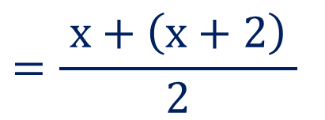
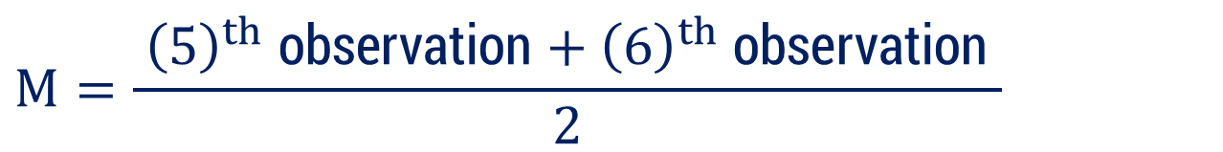
Method 2.2 ⇝ Example 2 (Continue)
$$29, 32, 48, 50, x, x+2, 72, 78, 84, 95$$
$$M=63$$
$$M=\frac{ {\left(\frac{n}{ 2 }\right)}^{th} \text{observation}+{\left(\frac{n}{ 2 }+1\right)}^{th} \text{observation} }{2}$$
$$M=\frac{ {\left(5\right)}^{th} \text{observation}+{\left(6\right)}^{th} \text{observation} }{2}$$
$$⇒$$
$$=\frac{ x+\left(x+2\right) }{2}$$
$$⇒$$
$$63$$
$$⇒$$
$$x =62$$

Slide 44












Method 2.2 ⇝ Example 3
Calculate the median for the following data:
Marks | 20 | 9 | 25 | 50 | 40 | 80
No. of students | 6 | 4 | 16 | 7 | 8 | 2
Solution:
Arrange the data in ascending order of marks.
Marks
No. of students
$$9$$
$$20$$
$$25$$
$$40$$
$$50$$
$$80$$
$$4$$
$$6$$
$$16$$
$$8$$
$$7$$
$$2$$

Slide 45









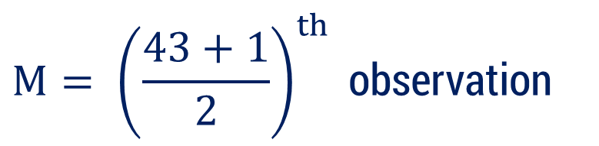






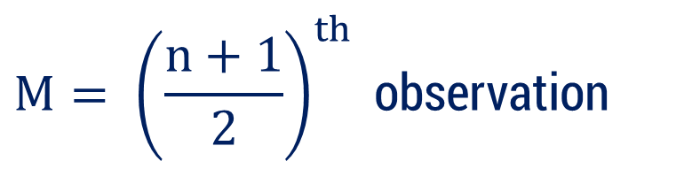

















Method 2.2 ⇝ Example 3 (Continue)
$$x$$ | $$f_{i}$$ | $$cf_{i}$$
Here,
$$n=43$$
(odd)
$$9$$
$$4$$
$$4$$
$$M= {\left(\frac{n+1}{2}\right)}^{th} \text{observation}$$
$$20$$
$$6$$
$$4+6$$
$$=10$$
$$⇒$$
$$25$$
$$16$$
$$10+16$$
$$=26$$
$$40$$
$$8$$
$$26+8$$
$$=34$$
$$M= {\left(\frac{43+1}{2}\right)}^{th} \text{observation}$$
$$⇒$$
$$50$$
$$7$$
$$34+7$$
$$=41$$
$$80$$
$$2$$
$$41+2$$
$$=43$$
$$⇒$$
$$M= {\left(22\right)}^{th} \text{observation}$$
$$\sum{f_{i}=}43$$
$$⇒$$
$$M=25$$

Slide 46


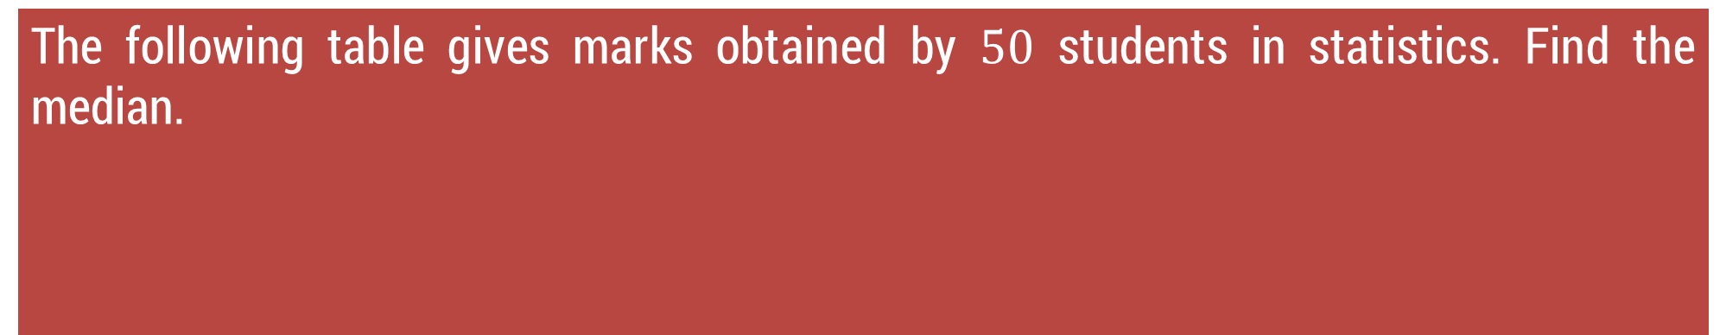








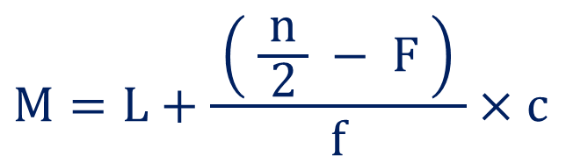
Method 2.2 ⇝ Example 4
The following table gives marks obtained by $50$ students in statistics. Find the median.
Marks
No. of students
$$0−10$$
$$10−20$$
$$20−30$$
$$30−40$$
$$40−50$$
$$16$$
$$12$$
$$18$$
$$3$$
$$1$$
Solution:
Formula to calculate median is
$$M=L+\frac{ \left( \frac{n}{ 2 } − F \right) }{f}×c$$

Slide 47



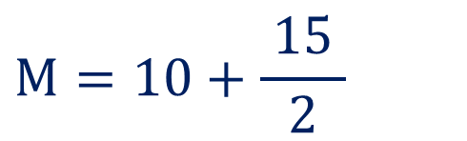







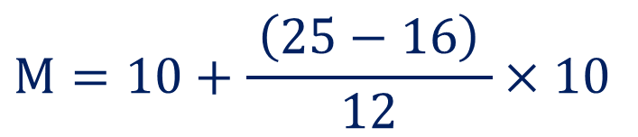












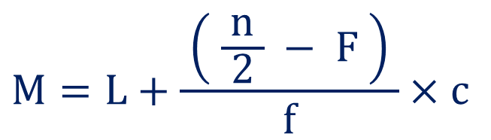






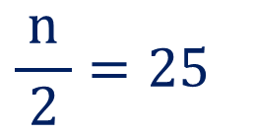


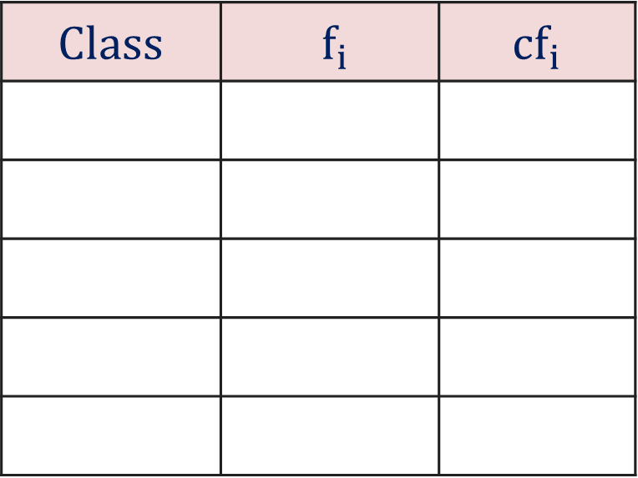
Method 2.2 ⇝ Example 4 (Continue)
$$Class$$ | $$f_{i}$$ | $$cf_{i}$$
$$M=L+\frac{ \left( \frac{n}{ 2 } − F \right) }{f}×c$$
$$0−10$$
$$16$$
$$16$$
$$10−20$$
$$12$$
$$28$$
$$20−30$$
$$18$$
$$46$$
$$M=10+\frac{ \left(25−16\right) }{12}×10$$
$$⇒$$
$$30−40$$
$$3$$
$$49$$
$$40−50$$
$$1$$
$$50$$
$$M=10+\frac{ 15 }{2}$$
$$⇒$$
$$\sum{f_{i}}$$
$$\frac{n}{ 2 }=25$$
$$=n$$
$$=50$$
$$⇒$$
$$⇒$$
$$M=17.5$$
Median class :
$$10−20$$
$$⇒$$
$$L=10$$
$$f$$
$$=12$$
$$F$$
$$=16$$
$$c=10$$

Slide 48




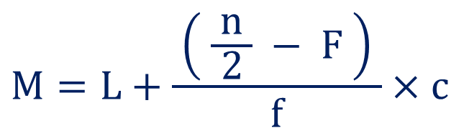












Method 2.2 ⇝ Example 5
The median of $60$ observations (following data) is $28.5$. Find $x$ and $y$
Marks
No. of students
$$0−10$$
$$10−20$$
$$20−30$$
$$30−40$$
$$40−50$$
$$50−60$$
$$5$$
$$x$$
$$20$$
$$15$$
$$y$$
$$5$$
Solution:
Given that
$$\sum{f_{i}}$$
$$M=28.5$$
$$=n=60$$
Formula to calculate median is
$$M=L+\frac{ \left( \frac{n}{ 2 } − F \right) }{f}×c$$

Slide 49













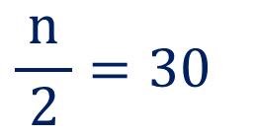

















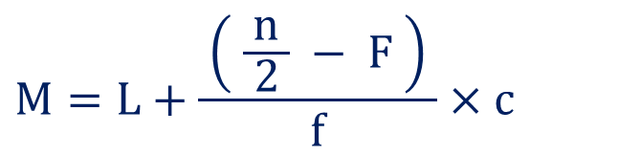



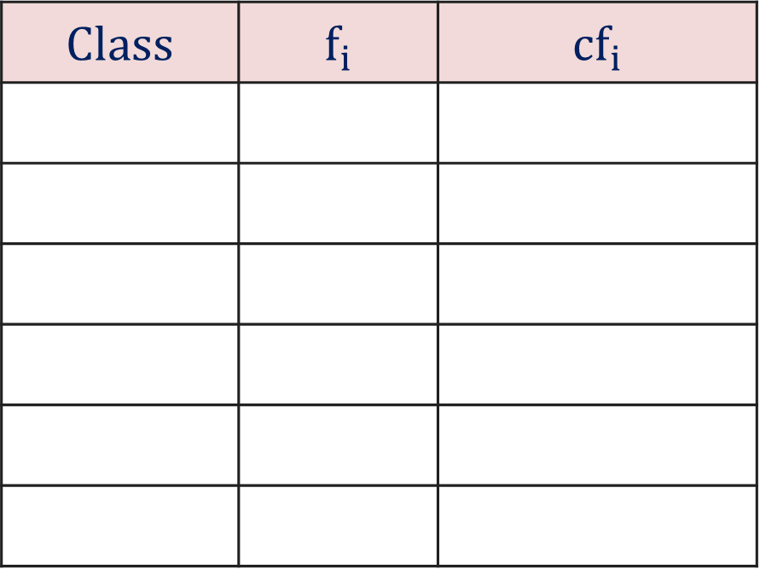
Method 2.2 ⇝ Example 5 (Continue)
$$Class$$ | $$f_{i}$$ | $$cf_{i}$$
$$M=28.5$$
$$0−10$$
$$5$$
$$5$$
Median class :
$$20−30$$
$$⇒$$
$$L=20$$
$$10−20$$
$$x$$
$$5+x$$
$$f$$
$$=20$$
$$F$$
$$=5+x$$
$$20−30$$
$$20$$
$$25+x$$
$$c=10$$
$$30−40$$
$$15$$
$$40+x$$
$$40−50$$
$$y$$
$$40+x+y$$
Note that
$$50−60$$
$$5$$
$$45+x+y$$
$$45+x+y=60$$
$$⇒$$
$$x+y=15$$
$$\sum{f_{i}}$$
$$\frac{n}{ 2 }=30$$
$$=n=60$$
$$⇒$$
$$M=L+\frac{ \left( \frac{n}{ 2 } − F \right) }{f}×c$$

Slide 50

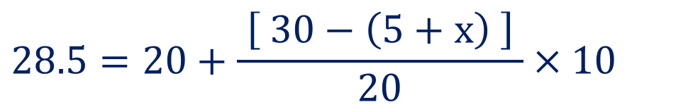






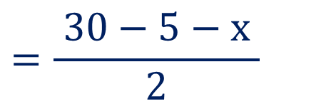




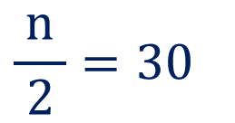



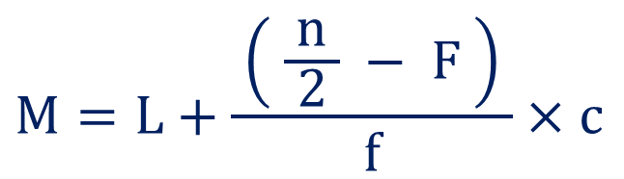












Method 2.2 ⇝ Example 5 (Continue)
$$\frac{n}{ 2 }=30$$
$$M=28.5$$
$$L=20$$
$$f$$
$$=20$$
$$F$$
$$=5+x$$
$$c=10$$
$$x+y=15$$
$$M=L+\frac{ \left( \frac{n}{ 2 } − F \right) }{f}×c$$
$$⇒$$
$$\left( 8.5 \right) 2$$
$$=25−x$$
$$⇒$$
$$x$$
$$=25−17$$
$$⇒$$
$$x$$
$$=8$$
$$28.5=20+\frac{ \left[ 30−\left(5+x\right) \right] }{20}×10$$
$$⇒$$
Now,
$$x+y=15$$
$$=\frac{ 30−5−x }{2}$$
$$⇒$$
$$28.5−20$$
$$⇒$$
$$8+y=15$$
$$⇒$$
$$y$$
$$=7$$

Slide 51
Method 2.3 Mode

Slide 52
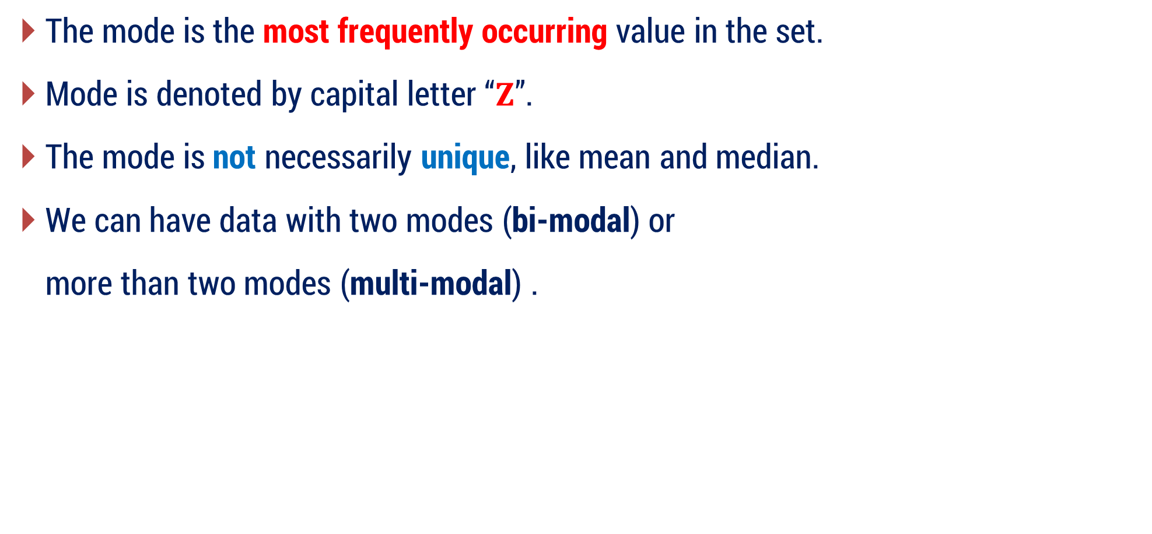
Mode
The mode is the most frequently occurring value in the set.
Mode is denoted by capital letter “$Z$”.
The mode is not necessarily unique, like mean and median.
We can have data with two modes (bi-modal) or
more than two modes (multi-modal) .

Slide 53
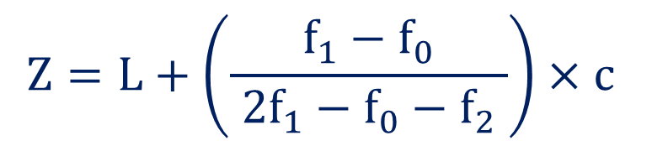
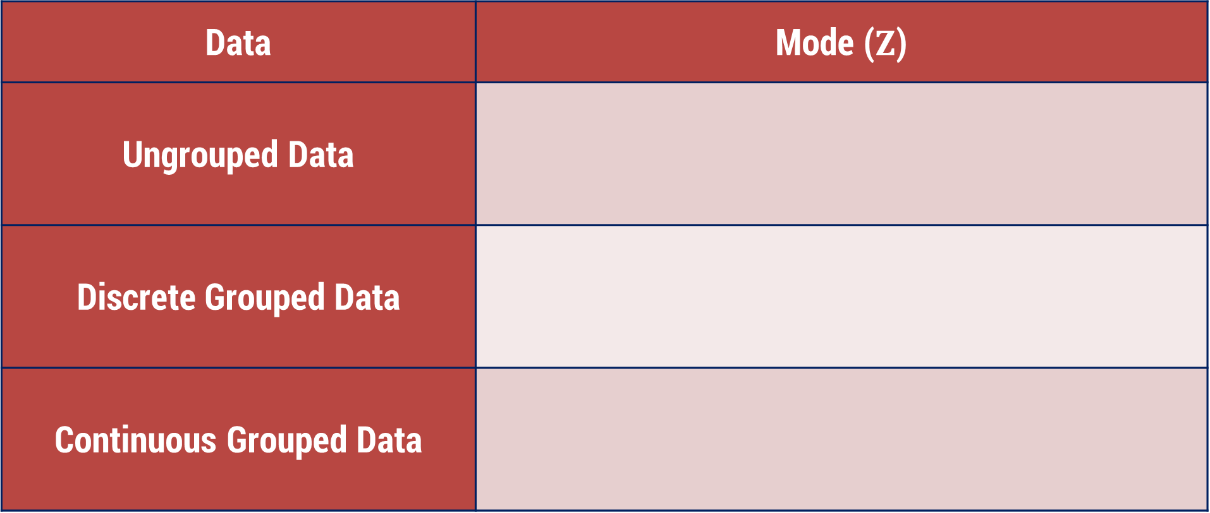
Mode
Data | Mode ($Z$)
Ungrouped Data
Discrete Grouped Data
Continuous Grouped Data
Most repeated observation among given data
Observation against the highest frequency
$$Z=L+\left(\frac{ f_{1}−f_{0} }{ 2f_{1}−f_{0}−f_{2} }\right)×c$$

Slide 54
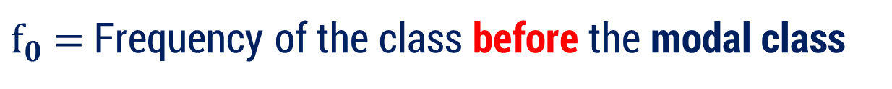
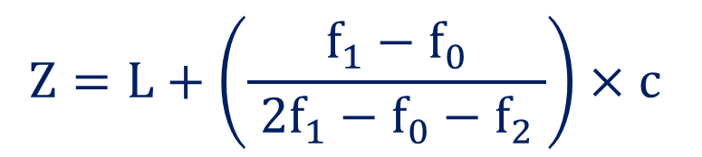
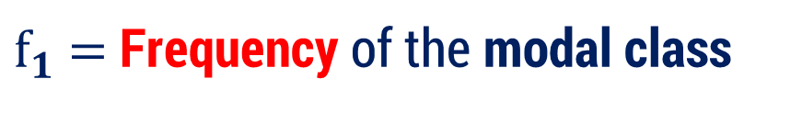
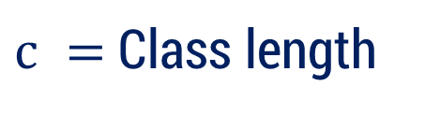
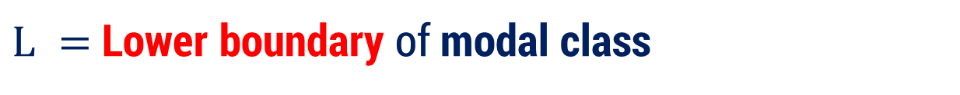
Mode
$$Z=L+\left(\frac{ f_{1}−f_{0} }{ 2f_{1}−f_{0}−f_{2} }\right)×c$$
Where,
$$\text{Modal} \text{class}=\text{A} \text{class} \text{with} \text{highest} \text{frequency}$$
$L =$Lower boundary of modal class
$f_{1}$ $=$ Frequency of the modal class
(Highest frequency)
$f_{0}$ $=$ Frequency of the class before the modal class
$f_{2}$ $=$ Frequency of the class after the modal class
$c =$Class length

Slide 55
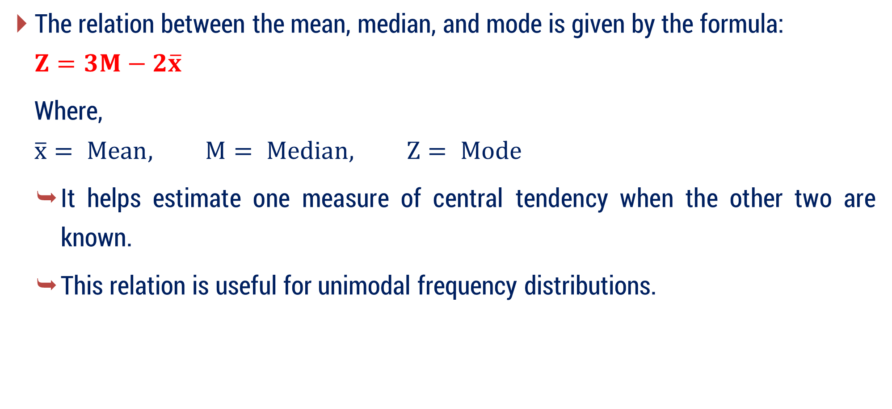
Relation Between Mean, Median, and Mode
The relation between the mean, median, and mode is given by the formula:
$$Z=3M−2\overline{x}$$
Where,
$$\overline{x}= Mean, M= Median, Z= Mode$$
It helps estimate one measure of central tendency when the other two are known.
This relation is useful for unimodal frequency distributions.

Slide 56






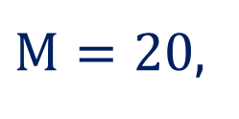


Method 2.3 ⇝ Example 1
If mean is $16$ and median is $20$. Calculate the mode.
Solution:
Given that,
$M=20$,
$$\overline{x}=16$$
We know that,
$$Z=3M−2\overline{x}$$
$$⇒$$
$$Z$$
$$=3(20)$$
$$− 2(16)$$
$$⇒$$
$$Z=28$$

Slide 57

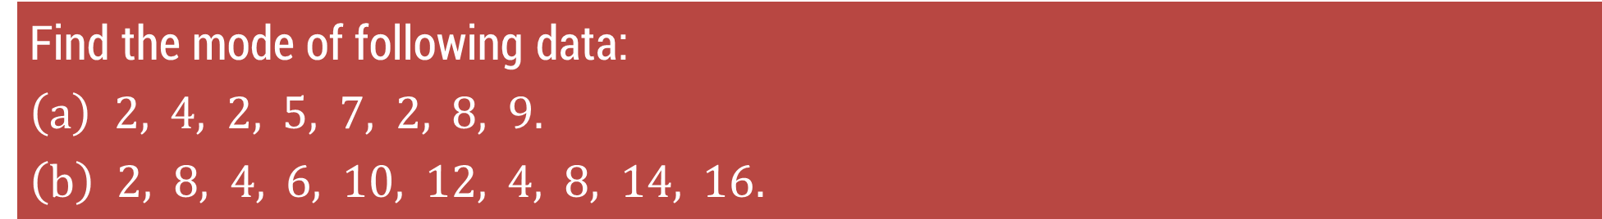





Method 2.3 ⇝ Example 2
Find the mode of following data:
$$\left(a\right) 2, 4, 2, 5, 7, 2, 8, 9.$$
$$\left(b\right) 2, 8, 4, 6, 10, 12, 4, 8, 14, 16.$$
Solution:
$$\left(a\right) 2, 4, 2, 5, 7, 2, 8, 9$$
Here,
Observation $2$ is repeated
Unimodal dataset
So,
$$Z=2$$
$$\left(b\right) 2, 8, 4, 6, 10, 12, 4, 8, 14, 16$$
Here,
Observation $8$ is repeated
Also,
Observation $4$ is repeated
Bimodal dataset
$$Z=4,$$
So,
$$8$$

Slide 58
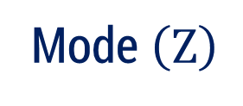



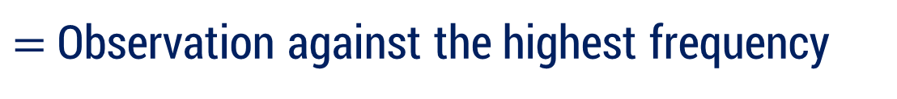
Method 2.3 ⇝ Example 3
Find the mode of following data:
x | 11 | 22 | 33 | 44
f | 15 | 20 | 19 | 10
Solution:
x | 11 | 22 | 33 | 44
f | 15 | 20 | 19 | 10
For Discrete Grouped Data
Mode $\left(Z\right)$
$=$ Observation against the highest frequency
Here,
highest frequently in given data is
$$20$$
$$⇒$$
$$Z=22$$

Slide 59














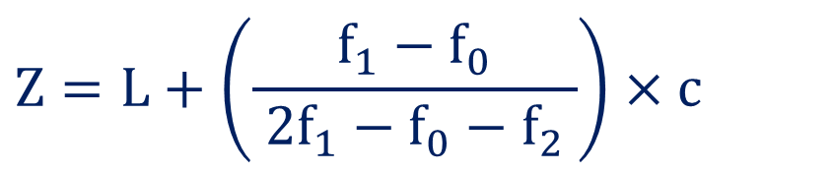






Method 2.3 ⇝ Example 4
Find the mode of following data:
Class
f
$$0−10$$
$$10−20$$
$$20−30$$
$$30−40$$
$$40−50$$
$$3$$
$$5$$
$$7$$
$$10$$
$$12$$
$$50−60$$
$$60−70$$
$$70−80$$
$$80−90$$
$$90−100$$
$$15$$
$$12$$
$$6$$
$$2$$
$$8$$
Solution:
Formula for the Mode
$$Z=L+\left(\frac{f_{1}−f_{0}}{ 2f_{1}−f_{0}−f_{2} }\right)×c$$

Slide 60


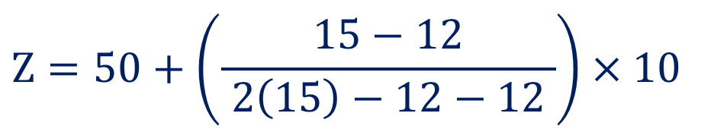


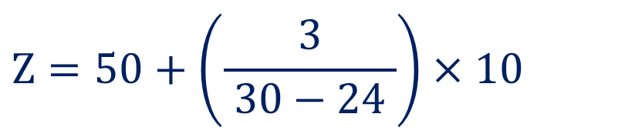







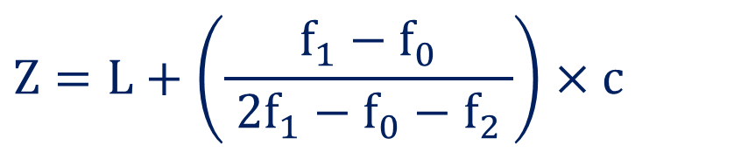



















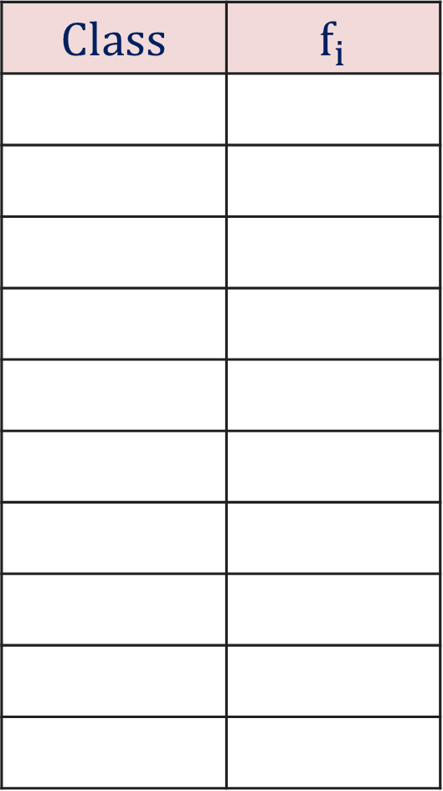





Method 2.3 ⇝ Example 4 (Continue)
$$Class$$ | $$f_{i}$$
Modal class:
$$Z=L+\left(\frac{f_{1}−f_{0}}{ 2f_{1}−f_{0}−f_{2} }\right)×c$$
$$0−10$$
$$3$$
$$50−60$$
$$10−20$$
$$5$$
$$L=50$$
$$20−30$$
$$7$$
$$f_{0}$$
$$=12$$
$$Z=50+\left(\frac{15−12}{ 2\left(15\right)−12−12 }\right)×10$$
$$⇒$$
$$30−40$$
$$10$$
$$f_{1}$$
$$=15$$
$$40−50$$
$$12$$
$$f_{2}$$
$$=12$$
$$Z=50+\left(\frac{3}{ 30−24 }\right)×10$$
$$50−60$$
$$15$$
$$⇒$$
$$c=10$$
$$60−70$$
$$12$$
$$70−80$$
$$6$$
$$⇒$$
$$Z=50+5$$
$$80−90$$
$$2$$
$$90−100$$
$$8$$
$$⇒$$
$$Z=55$$

Slide 61




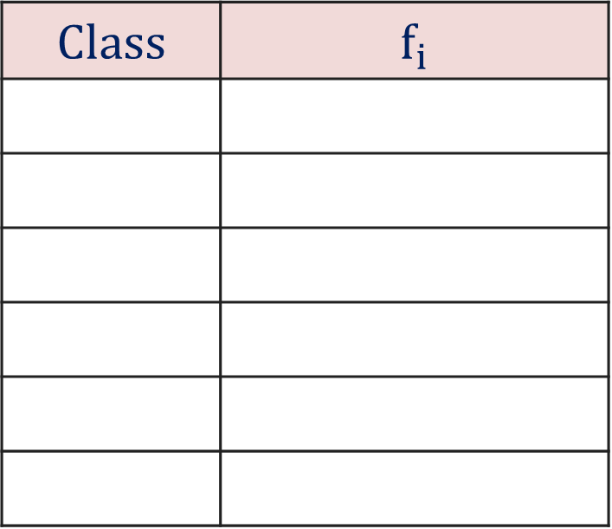





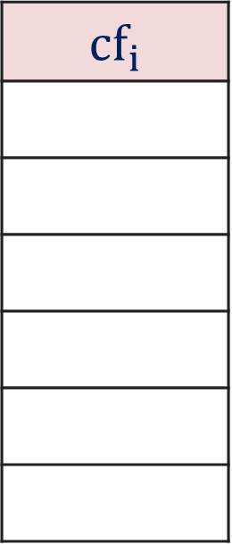



















Method 2.3 ⇝ Example 5
Obtain the mean, mode and median for the following information:
x | < 10 | < 20 | < 30 | < 40 | < 50 | < 60
f | 12 | 30 | 57 | 77 | 94 | 100
Solution:
$$Class$$ | $$f_{i}$$
$$cf_{i}$$
$$0−10$$
$$12$$
$$12$$
Firstly we will calculate
$$10−20$$
$$30−12$$
$$=$$
$$18$$
$$30$$
Median
$$20−30$$
$$57−30$$
$$=$$
$$27$$
$$57$$
$$30−40$$
$$77−57$$
$$=$$
$$20$$
$$77$$
$$40−50$$
$$94−77$$
$$=$$
$$17$$
$$94$$
$$50−60$$
$$100−94$$
$$=$$
$$6$$
$$100$$

Slide 62
















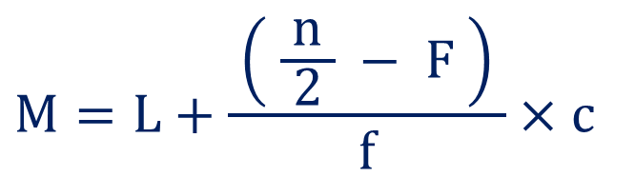





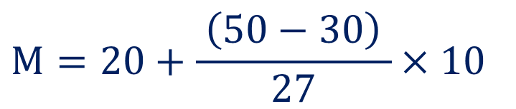











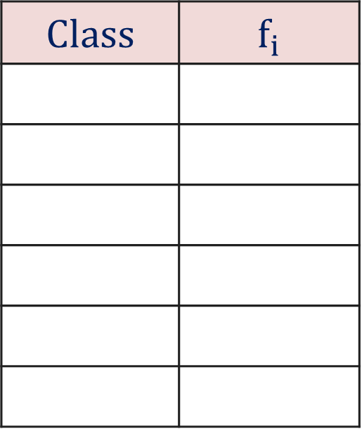


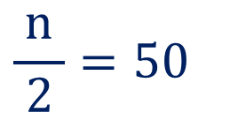


Method 2.3 ⇝ Example 5 (Continue)
Mean (Direct Method)
Median
$$Class$$ | $$f_{i}$$
$$cf_{i}$$
Median class :
$$M=L+\frac{ \left( \frac{n}{ 2 } − F \right) }{f}×c$$
$$0−10$$
$$12$$
$$12$$
$$20−30$$
$$10−20$$
$$18$$
$$30$$
$$L=20$$
$$20−30$$
$$27$$
$$57$$
$$M=20+\frac{ \left(50−30\right) }{27}×10$$
$$f$$
$$=27$$
$$⇒$$
$$30−40$$
$$20$$
$$77$$
$$F$$
$$=30$$
$$40−50$$
$$17$$
$$94$$
$$⇒$$
$$M=20+7.41$$
$$c=10$$
$$50−60$$
$$6$$
$$100$$
$$⇒$$
$$M=27.41$$
$$\sum{f_{i}}$$
$$\frac{n}{ 2 }=50$$
$$=$$
$$n$$
$$=100$$
$$⇒$$

Slide 63
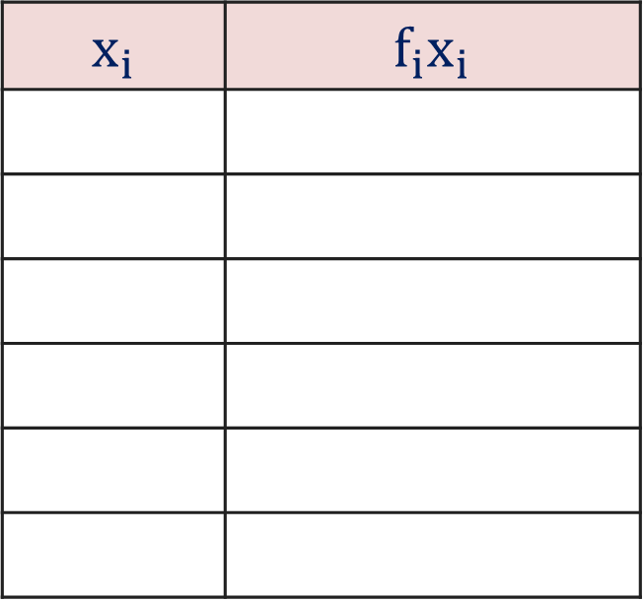









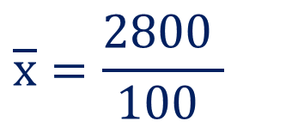





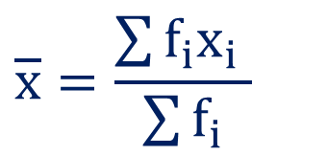




Method 2.3 ⇝ Example 5 (Continue)
Mode
Mean (Direct Method)
$$Class$$ | $$f_{i}$$
$$x_{i}$$ | $$f_{i}x_{i}$$
$$\overline{x}=\frac{\sum{f_{i}x_{i}} }{\sum{f_{i}}}$$
$$0−10$$
$$12$$
$$5$$
$$60$$
$$10−20$$
$$18$$
$$15$$
$$270$$
$$\overline{x}=\frac{2800 }{100 }$$
$$⇒$$
$$20−30$$
$$27$$
$$25$$
$$675$$
$$30−40$$
$$20$$
$$35$$
$$700$$
$$⇒$$
$$\overline{x}=28$$
$$40−50$$
$$17$$
$$45$$
$$765$$
$$50−60$$
$$6$$
$$55$$
$$330$$
$$\sum{f_{i}}x_{i}=2800$$
$$\sum{f_{i}}$$
$$=100$$

Slide 64

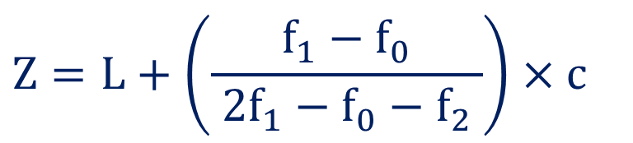















Method 2.3 ⇝ Example 5 (Continue)
Mode
Modal class:
$$Z=L+\left(\frac{f_{1}−f_{0}}{ 2f_{1}−f_{0}−f_{2} }\right)×c$$
$$Class$$ | $$f_{i}$$
$$20−30$$
$$0−10$$
$$12$$
$$L=20$$
$$10−20$$
$$18$$
$$f_{0}$$
$$=18$$
$$Z=20+\left(\frac{27−18}{ 2\left(27\right)−18−20 }\right)×10$$
$$⇒$$
$$20−30$$
$$27$$
$$f_{1}$$
$$=27$$
$$30−40$$
$$20$$
$$f_{2}$$
$$=20$$
$$Z=20+\left(\frac{9}{ 54−38 }\right)×10$$
$$40−50$$
$$17$$
$$⇒$$
$$c=10$$
$$50−60$$
$$6$$
$$Z=20+\left(\frac{9}{ 16 }\right)×10$$
$$⇒$$
$$⇒$$
$$Z=25.63$$

Slide 65
Method 3 Measure of Variability

Slide 66

Measure of Variability
Measure of Variability :
It refers to the spread of the values around the central tendency.
It is known as Measure of Dispersion.
For example:
$−5, 0, 5$ and $−50, 0, 50$ both have the same mean $0$ but clearly the data given in the second case much more widely dispersed than those in the first case.
So, measures of central tendency are not sufficient for having some idea about dispersion.

Slide 67

Measure of Variability
Measures of dispersion gives the idea about the degree to which numerical data tend to spread about an average life.
There are certain measures of variability,
Range
Standard Deviation $\left( σ \right)$
Mean Deviation

Slide 68

Range
Range is simply the highest value minus the lowest value of a set of data values.
For example:
Range of $−5, 0, 5$ is $10$
Reason:
$$\text{Range}=\text{Highest} \text{value}−\text{L}\text{owest} \text{value}$$
$$=5−\left(−5\right)$$
$$=10$$

Slide 69

Standard Deviation
Standard deviation is a measure that is used to quantify the amount of variation or dispersion of a set of data values.
It is denoted by “$σ$" and read as “sigma”.

Slide 70




Standard Deviation
Method | Ungrouped Data | Discrete Grouped Data | Continuous Grouped Data
Direct Method
Assumed Mean Method
$$\sqrt{ \frac{\sum{x_{i}^{2}} }{n }−{\left(\frac{ \sum{x_{i}} }{n }\right)}^{2} }$$
$$\sqrt{ \frac{\sum{f_{i}x_{i}^{2}} }{\sum{f_{i}} }−{\left(\frac{ \sum{f_{i}x_{i}} }{\sum{f_{i}}}\right)}^{2} }$$
$$\sqrt{ \frac{\sum{d_{i}^{2}} }{n }−{\left(\frac{ \sum{d_{i}} }{n }\right)}^{2} }$$
$$\sqrt{ \frac{\sum{f_{i}d_{i}^{2}} }{\sum{f_{i}} }−{\left(\frac{ \sum{f_{i}d_{i}} }{\sum{f_{i}}}\right)}^{2} }$$

Slide 71

Standard Deviation
Method | Ungrouped Data | Discrete Grouped Data | Continuous Grouped Data
Step Deviation Method
$$\sqrt{\frac{ \sum{ f_{i}u_{i}^{2}} }{ \sum{ f_{i}}}−{\left(\frac{ \sum{ f_{i}u_{i}} }{ \sum{f_{i}} }\right)}^{2} }×c$$
-----
-----

Slide 72

Variance
Variance is expectation of the squared deviation.
It informally measures how far a set of (random) numbers are spread out from their mean.
It is denoted by capital letter “$V$” and defined as $V=σ^{2}$.

Slide 73

Coefficient of Variation
The Coefficient of Variation is the ratio of the standard deviation to the mean and shows the extent of variability in relation to the mean of the population.
Coefficient of Variance is defined as
$$C.V.=\frac{ σ }{\overline{x}}×100$$
If $C.V.$ is high, then it is less consistent. Similarly, if $C.V.$ is less, then it is more consistent.
The higher the Coefficient of Variation, the greater the dispersion.

Slide 74
Mean Deviation
The mean deviation is defined as a statistical measure that is used to calculate the average deviation from the mean value of the given data set.
In a simple word, the mean deviation is used to calculate how far the values fall from the middle of the data set.

Slide 75






Mean Deviation
Method | Ungrouped Data | Grouped Data
M.D. about Mean
M.D. about Median
M.D. about Mode
$$\frac{ \sum{\left| x_{i}−\overline{ x } \right| }}{n}$$
$$\frac{ \sum{f_{i} \left| x_{i}−\overline{ x } \right| }}{\sum{f_{i} }}$$
$$\frac{ \sum{\left| x_{i}−M \right| }}{n}$$
$$\frac{ \sum{f_{i} \left| x_{i}−M \right| }}{\sum{f_{i} }}$$
$$\frac{ \sum{\left| x_{i}−Z \right| }}{n}$$
$$\frac{ \sum{f_{i} \left| x_{i}−Z \right| }}{\sum{f_{i} }}$$

Slide 76










Method 3 ⇝ Example 1
Find the standard deviation for the following data:
, , , , , , ,
$$6$$
$$7$$
$$10$$
$$12$$
$$13$$
$$4$$
$$8$$
$$12$$
Solution:
Total number of observations are
$$n=8$$
We will calculate standard deviation using direct method
$$σ=\sqrt{ \frac{ \sum{x_{i}^{2}} }{n }−{\left(\frac{ \sum{x_{i}} }{n }\right)}^{2} }$$

Slide 77

























Method 3 ⇝ Example 1 (Continue)
$$x_{i}$$ | $$x_{i}^{2}$$
$$n=8$$
$$6$$
$$36$$
$$σ=\sqrt{ \frac{ \sum{x_{i}^{2}} }{n }−{\left(\frac{ \sum{x_{i}} }{n }\right)}^{2} }$$
$$7$$
$$49$$
$$10$$
$$100$$
$$12$$
$$144$$
$$13$$
$$σ=\sqrt{ \frac{722 }{8 }−{\left(\frac{ 72 }{8}\right)}^{2} }$$
$$169$$
$$⇒$$
$$4$$
$$16$$
$$8$$
$$64$$
$$12$$
$$144$$
$$⇒$$
$$σ=3.0414$$
$$\sum{x_{i}}=72$$
$$\sum{x_{i}^{2}}=722$$

Slide 78











Method 3 ⇝ Example 2
Find the standard deviation for the following distribution:
x
f
$$2$$
$$4$$
$$6$$
$$8$$
$$10$$
$$3$$
$$4$$
$$2$$
$$1$$
$$6$$
Solution:
Using direct method to calculate S.D.:
$$σ=\sqrt{ \frac{ \sum{f_{i}x_{i}^{2}} }{\sum{f_{i}} }−{\left(\frac{ \sum{f_{i}x_{i}} }{\sum{f_{i}}}\right)}^{2} }$$

Slide 79





























Method 3 ⇝ Example 2 (Continue)
$$x$$ | $$f_{i}$$ | $$f_{i}x_{i}$$ | $$f_{i}x_{i}^{2}$$
$$σ=\sqrt{ \frac{ \sum{f_{i}x_{i}^{2}} }{\sum{f_{i}} }−{\left(\frac{ \sum{f_{i}x_{i}} }{\sum{f_{i}}}\right)}^{2} }$$
$$2$$
$$3$$
$$6$$
$$12$$
$$4$$
$$4$$
$$16$$
$$64$$
$$σ=\sqrt{ \frac{ 812 }{16}−{\left(\frac{ 102 }{16}\right)}^{2} }$$
$$6$$
$$2$$
$$12$$
$$72$$
$$⇒$$
$$8$$
$$1$$
$$8$$
$$64$$
$$10$$
$$6$$
$$60$$
$$600$$
$$\sum{f_{i}}=16$$
$$\sum{f_{i}x_{i}}=102$$
$$\sum{f_{i}x_{i}^{2}}=812$$
$$⇒$$
$$σ=3.1795$$

Slide 80















Method 3 ⇝ Example 3
Find the standard deviation and variance for the following distribution
Class
f
$$0−10$$
$$10−20$$
$$20−30$$
$$30−40$$
$$40−50$$
$$50−60$$
$$60−70$$
$$6$$
$$14$$
$$10$$
$$8$$
$$1$$
$$3$$
$$8$$
Solution:
Using step deviation method to calculate S.D.:
$$σ=\sqrt{ \frac{ \sum{f_{i}u_{i}^{2}} }{\sum{f_{i}} }−{\left(\frac{ \sum{f_{i}u_{i}} }{\sum{f_{i}}}\right)}^{2}}×c$$

Slide 81

















































Method 3 ⇝ Example 3 (Continue)
$$Class$$ | $$f_{i}$$ | $$x_{i}$$ | $$u_{i}$$ | $$f_{i}u_{i}$$ | $$f_{i}u_{i}^{2}$$
$$0−10$$
$$6$$
$$5$$
$$−3$$
$$−18$$
$$54$$
$$10−20$$
$$14$$
$$15$$
$$−2$$
$$−28$$
$$56$$
$$20−30$$
$$10$$
$$25$$
$$−1$$
$$−10$$
$$10$$
$$30−40$$
$$8$$
$$35$$
$$=A$$
$$0$$
$$0$$
$$0$$
$$40−50$$
$$1$$
$$45$$
$$1$$
$$1$$
$$1$$
$$50−60$$
$$3$$
$$55$$
$$2$$
$$6$$
$$12$$
$$c=10$$
$$60−70$$
$$8$$
$$65$$
$$3$$
$$24$$
$$72$$
$$\sum{f_{i}}=50$$
$$\sum{f_{i}u_{i}}=−25$$
$$\sum{f_{i}u_{i}^{2}}=205$$
$$σ=\sqrt{ \frac{ \sum{f_{i}u_{i}^{2}} }{\sum{f_{i}} }−{\left(\frac{ \sum{f_{i}u_{i}} }{\sum{f_{i}}}\right)}^{2}}×c$$

Slide 82









Method 3 ⇝ Example 3 (Continue)
$$\sum{f_{i}}=50$$
$$\sum{f_{i}u_{i}}=−25$$
$$\sum{f_{i}u_{i}^{2}}=205$$
$$c=10$$
$$σ=\sqrt{ \frac{ \sum{f_{i}u_{i}^{2}} }{\sum{f_{i}} }−{\left(\frac{ \sum{f_{i}u_{i}} }{\sum{f_{i}}}\right)}^{2}}×c$$
$$σ=\sqrt{ \frac{ 205 }{50}−{\left(\frac{ −25 }{50}\right)}^{2} }×10$$
$$⇒$$
$$⇒$$
$$σ=19.6214$$

Slide 83

















Method 3 ⇝ Example 4
The arithmetic means of runs scored by three batsmen $A, B and C,$ in the same series of $10$ innings, are $50, 48$ and $12$ respectively. The standard deviations of their runs are $15, 12 and 2$ respectively. Who is the most consistent of the three?
Solution:
For Batsman $A$:
For Batsman $B$:
For Batsman $C$:
$${\overline{x}}_{A}$$
$$=50$$
$${\overline{x}}_{B}$$
$$=48$$
$${\overline{x}}_{C}$$
$$=12$$
$$σ_{A}$$
$$=15$$
$$σ_{B}$$
$$=12$$
$$σ_{C}$$
$$=2$$
To determine the most consistent batsman,
we need to compare the coefficient of variation (CV) for each batsman.
$$C.V.=\frac{ σ }{ \overline{x} }×100$$

Slide 84


























Method 3 ⇝ Example 4 (Continue)
For Batsman $A$:
For Batsman $B$:
For Batsman $C$:
$${\overline{x}}_{A}$$
$$=50$$
$$σ_{A}$$
$$=15$$
$${\overline{x}}_{B}$$
$$=48$$
$$σ_{B}$$
$$=12$$
$${\overline{x}}_{C}$$
$$=12$$
$$σ_{C}$$
$$=2$$
$$C.V.=\frac{ σ_{A} }{ {\overline{x}}_{A} }×100$$
$$C.V.=\frac{ σ_{B} }{ {\overline{x}}_{B} }×100$$
$$C.V.=\frac{ σ_{C} }{ {\overline{x}}_{C} }×100$$
$$=\frac{ 15 }{50}×100$$
$$=\frac{ 12 }{48}×100$$
$$=\frac{ 2 }{ 12 }×100$$
$$=30\%$$
$$=25\%$$
$$=16.6667\%$$
Batsman $C$ has the lowest coefficient of variation.
So, he is the most consistent.
$$C.V.=\frac{ σ }{ \overline{x} }×100$$

Slide 85





















Method 3 ⇝ Example 5
Two machines $A$, $B$ are used to fill a mixture of cement concrete in a beam. Find the standard deviation of each machine & comment on the performances of two machines.
A
B
$$32$$
$$28$$
$$47$$
$$63$$
$$71$$
$$39$$
$$10$$
$$60$$
$$96$$
$$14$$
$$19$$
$$31$$
$$48$$
$$53$$
$$67$$
$$90$$
$$10$$
$$72$$
$$40$$
$$80$$
Solution:

Slide 86















































Method 3 ⇝ Example 5 (Continue)
$$A \left(x_{i}\right)$$ | $$x_{i}^{2}$$
$$\sum{x_{i}}=460$$
$$B \left(y_{i}\right)$$ | $$y_{i}^{2}$$
$$\sum{y_{i}}=510$$
$$32$$
$$1024$$
$$19$$
$$361$$
$$28$$
$$784$$
$$31$$
$$961$$
$$\sum{x_{i}^{2}}=27660$$
$$\sum{y_{i}^{2}}=32308$$
$$47$$
$$2209$$
$$48$$
$$2304$$
$$63$$
$$3969$$
$$53$$
$$2809$$
$$71$$
$$5041$$
$$67$$
$$4489$$
$$n=10$$
$$39$$
$$1521$$
$$90$$
$$8100$$
$$10$$
$$100$$
$$10$$
$$100$$
$$60$$
$$3600$$
$$72$$
$$5184$$
$$96$$
$$9216$$
$$40$$
$$1600$$
$$14$$
$$196$$
$$80$$
$$6400$$

Slide 87















Method 3 ⇝ Example 5 (Continue)
$$\sum{x_{i}}=460$$
$$\sum{x_{i}^{2}}=27660$$
$$\sum{y_{i}}=510$$
$$\sum{y_{i}^{2}}=32308$$
$$n=10$$
Now,
and
$$σ_{A}=\sqrt{ \frac{ \sum{x_{i}^{2}} }{n}−{\left(\frac{ \sum{x_{i}} }{n}\right)}^{2} }$$
$$σ_{B}=\sqrt{ \frac{ \sum{y_{i}^{2}} }{n}−{\left(\frac{ \sum{y_{i}} }{n}\right)}^{2} }$$
$$σ_{A}=\sqrt{ \frac{ 27660 }{10}−{\left(\frac{ 460 }{10}\right)}^{2} }$$
$$σ_{B}=\sqrt{ \frac{ 32308 }{10}−{\left(\frac{ 510 }{10}\right)}^{2} }$$
$$⇒$$
$$⇒$$
$$⇒$$
$$σ_{A}=25.4951$$
$$⇒$$
$$σ_{B}=25.0958$$
There is less variability in the performance of the machine $B$.

Slide 88

Method 3 ⇝ Example 6
An analysis of monthly wages paid to the workers of two firms $A$ and $B$ belonging to the same industry gives the following results:
 | Firm A | Firm B
Number of workers | 500 | 600
Average daily wage | 186 | 175
Variance of distribution of wages | 81 | 100
(1) Which firm has a larger wage bill?
(2) In which firm, is there greater variability in individual wages?
Calculate average daily wages of all the workers in the firms A & B taken together.
Solution:

Slide 89








Method 3 ⇝ Example 6 (Continue)
 | Firm A | Firm B
Number of workers | 500 | 600
Average daily wage | 186 | 175
Variance of distribution of wages | 81 | 100
Firm $A$:
Firm $B$:
Number of workers:
$$n_{A}=500$$
Number of workers:
$$n_{B}=600$$
Average daily wage:
$${\overline{x}}_{A}=186$$
Average daily wage:
$${\overline{x}}_{B}=175$$
Variance:
$$V_{A}=σ_{A}^{2}=81$$
Variance:
$$V_{B}=σ_{B}^{2}=100$$
(1) Which firm has a larger wage bill?
(2) In which firm, is there greater variability in individual wages?
Calculate average daily wages of all the workers in the firms A & B taken together.

Slide 90
















Method 3 ⇝ Example 6 (Continue)
Firm $A$:
$$n_{A}=500$$
$${\overline{x}}_{A}=186$$
$$V_{A}=σ_{A}^{2}=81$$
Firm $B$:
$$n_{B}=600$$
$${\overline{x}}_{B}=175$$
$$V_{B}=σ_{B}^{2}=100$$
(1) Which firm has a larger wage bill?
The wage bill is the total wages paid by each firm, calculated as:
Wage bill of Firm $A$
$$=n_{A}⋅{\overline{x}}_{A} ​$$
$$=500⋅186 ​$$
$$=93000$$
Wage bill of Firm $B$
$$=n_{B}⋅{\overline{x}}_{B} ​$$
$$=600⋅175 ​$$
$$=105000$$
Firm B has a larger wage bill.
(2) In which firm, is there greater variability in individual wages?
Calculate average daily wages of all the workers in the firms A & B taken together.

Slide 91













Method 3 ⇝ Example 6 (Continue)
Firm $A$:
$$n_{A}=500$$
$${\overline{x}}_{A}=186$$
$$V_{A}=σ_{A}^{2}=81$$
$$⇒$$
$$σ_{A}=9$$
$$⇒$$
$$σ_{B}=10$$
Firm $B$:
$$n_{B}=600$$
$${\overline{x}}_{B}=175$$
$$V_{B}=σ_{B}^{2}=100$$
(2) In which firm, is there greater variability in individual wages?
$$C.V.=\frac{ σ }{ \overline{x} }×100$$
We measure variability using the Coefficient of Variation (CV):
For Firm $A$:
For Firm $B$:
$$C.V._{A}=\frac{ σ_{A} }{ {\overline{x}}_{A} }×100$$
$$C.V._{A}=\frac{ σ_{B} }{ {\overline{x}}_{B} }×100$$
Firm B has greater relative variability in wages
$$=\frac{ 9 }{ 186 }×100$$
$$=\frac{ 10 }{ 175 }×100$$
$$=4.8387\%$$
$$=5.7143\%$$
Calculate average daily wages of all the workers in the firms A & B taken together.

Slide 92







Method 3 ⇝ Example 6 (Continue)
Firm $A$:
$$n_{A}=500$$
$${\overline{x}}_{A}=186$$
$$V_{A}=σ_{A}^{2}=81$$
$$σ_{A}=9$$
Firm $B$:
$$n_{B}=600$$
$${\overline{x}}_{B}=175$$
$$V_{B}=σ_{B}^{2}=100$$
$$σ_{B}=10$$
Calculate average daily wages of all the workers in the firms A & B taken together.
Average of daily wages of all worker
$$=\frac{ \text{Total} \text{wage} \text{of} \text{both} \text{firms} }{\text{Total} \text{no}\text{. }\text{of} \text{workers}}$$
Wage bill of Firm $A$
$$=\frac{ 93000+105000 }{1100}$$
$$93000$$
Wage bill of Firm $B$
$$=180$$
$$105000$$

Slide 93


















Method 3 ⇝ Example 7
Find the mean deviation about the mean and median for the following data:
, , , , .
$$2$$
$$4$$
$$7$$
$$8$$
$$9$$
Solution:
Here, total number of observations are
$$n=5$$
(Odd)
Mean
Median
$$\overline{x}=\frac{\sum{x_{i}} }{n }$$
Observations are already in ascending order
$$M={\left(\frac{n+1}{2}\right)}^{th} \text{observation}$$
$$\overline{x}=\frac{2+4+7+8+9 }{5}$$
$$⇒$$
$$M={\left(\frac{5+1}{2}\right)}^{th} \text{observation}$$
$$⇒$$
$$⇒$$
$$\overline{x}=6$$
$$⇒$$
$$M=3^{rd} \text{observation}$$
$$⇒$$
$$M=7$$

Slide 94






























Method 3 ⇝ Example 7 (Continue)
$$\overline{x}=6$$
$$M=7$$
Mean Deviation About Mean
$$x$$
$$\left|x−\overline{x}\right|=|x−6|$$
$$\left|x−M\right|=|x−7|$$
$$MD\left(\overline{x}\right)=\frac{\sum{\left|x−\overline{x}\right|} }{n }$$
$$2$$
$$4$$
$$5$$
$$MD\left(\overline{x}\right)=\frac{ 12 }{5}$$
$$4$$
$$2$$
$$3$$
$$⇒$$
$$=2.4$$
$$7$$
$$1$$
$$0$$
$$8$$
$$2$$
$$1$$
Mean Deviation About Median
$$9$$
$$3$$
$$2$$
$$MD\left(M\right)=\frac{\sum{\left|x−M\right|} }{n }$$
$$\sum{\left|x−\overline{x}\right|}=12$$
$$\sum{\left|x−M\right|}=11$$
$$MD\left(M\right)=\frac{11 }{5 }$$
$$⇒$$
$$=2.2$$

Slide 95










Method 3 ⇝ Example 8
Find mean deviation about the mean, median and mode for the following data:
x
f
$$5$$
$$10$$
$$15$$
$$20$$
$$25$$
$$7$$
$$4$$
$$6$$
$$3$$
$$5$$
Solution:

Slide 96







































Method 3 ⇝ Example 8 (Continue)
$$x_{i}$$ | $$f_{i}$$
$$f_{i}x_{i}$$
$$\left|x_{i}−\overline{x}\right|$$ | $$f_{i}\left|x_{i}−\overline{x}\right|$$
$$\overline{x}=\frac{\sum{f_{i}}x_{i}}{\sum{f_{i}}}$$
$$5$$
$$7$$
$$35$$
$$9$$
$$63$$
$$10$$
$$4$$
$$40$$
$$4$$
$$16$$
$$\overline{x}=\frac{350}{25 }$$
$$⇒$$
$$15$$
$$6$$
$$90$$
$$1$$
$$6$$
$$20$$
$$3$$
$$60$$
$$6$$
$$18$$
$$⇒$$
$$\overline{x}=14$$
$$25$$
$$5$$
$$125$$
$$11$$
$$55$$
$$\sum{f_{i}}=25$$
$$\sum{f_{i}x_{i}}=350$$
$$\sum{f_{i}\left|x_{i}−\overline{x}\right|}=158$$
$$MD\left(\overline{x}\right)=\frac{\sum{f_{i}\left|x_{i}−\overline{x}\right|} }{\sum{f_{i}}}$$
$$=\frac{158 }{25 }$$
$$=6.32$$

Slide 97














Method 3 ⇝ Example 8 (Continue)
$$x_{i}$$ | $$f_{i}$$
$${cf}_{i}$$
Here,
$$n=23$$
(odd)
$$5$$
$$7$$
$$7$$
$$M= {\left(\frac{n+1}{2}\right)}^{th} \text{observation}$$
$$10$$
$$4$$
$$11$$
$$⇒$$
$$15$$
$$6$$
$$17$$
$$20$$
$$3$$
$$20$$
$$M= {\left(\frac{23+1}{2}\right)}^{th} \text{observation}$$
$$⇒$$
$$25$$
$$5$$
$$25$$
$$\sum{f_{i}}=25$$
$$⇒$$
$$M= {\left(12\right)}^{th} \text{observation}$$
$$⇒$$
$$M=25$$

Slide 98


















Method 3 ⇝ Example 8 (Continue)
$$x_{i}$$ | $$f_{i}$$
$$\left|x_{i}−M\right|$$ | $$f_{i}\left|x_{i}−M\right|$$
$$MD(M)=\frac{\sum{f_{i}\left|x_{i}−M\right|} }{\sum{f_{i}}}$$
$$5$$
$$7$$
$$10$$
$$70$$
$$10$$
$$4$$
$$5$$
$$20$$
$$15$$
$$6$$
$$0$$
$$0$$
$$MD(M)=\frac{155 }{25 }$$
$$⇒$$
$$20$$
$$3$$
$$5$$
$$15$$
$$25$$
$$5$$
$$10$$
$$50$$
$$⇒$$
$$MD(M)=6.2$$
$$\sum{f_{i}}=25$$
$$\sum{f_{i}\left|x_{i}−M\right|}=155$$
$$M=25$$

Slide 99


















Method 3 ⇝ Example 8 (Continue)
$$x_{i}$$ | $$f_{i}$$
$$\left|x_{i}−Z\right|$$ | $$f_{i}\left|x_{i}−Z\right|$$
$$MD\left(Z\right)=\frac{\sum{f_{i}\left|x−Z\right|} }{n }$$
$$5$$
$$7$$
$$0$$
$$0$$
$$10$$
$$4$$
$$5$$
$$20$$
$$MD\left(Z\right)=\frac{255 }{25 }$$
$$15$$
$$6$$
$$10$$
$$60$$
$$⇒$$
$$20$$
$$3$$
$$15$$
$$45$$
$$⇒$$
$$MD\left(Z\right)=9$$
$$25$$
$$5$$
$$20$$
$$100$$
$$\sum{f_{i}}=25$$
$$\sum{f_{i}\left|x_{i}−Z\right| }=225$$
$$Z=\text{Observation} \text{against} \text{highest} \text{freq}\text{.}$$
$$Z=5$$

Slide 100










Method 3 ⇝ Example 9
Find mean deviation about the mean, median and mode for the following data:
Class
f
$$5−25$$
$$25−45$$
$$45−65$$
$$65−85$$
$$85−105$$
$$12$$
$$8$$
$$14$$
$$20$$
$$6$$
Solution:

Slide 101






























Method 3 ⇝ Example 9 (Continue)
$$Class$$ | $$f_{i}$$
$$x_{i}$$
$$f_{i}x_{i}$$
$$\overline{x}=\frac{\sum{f_{i}}x_{i}}{\sum{f_{i}}}$$
$$5−25$$
$$12$$
$$15$$
$$180$$
$$25−45$$
$$8$$
$$35$$
$$280$$
$$\overline{x}=\frac{3300}{60 }$$
$$45−65$$
$$14$$
$$55$$
$$770$$
$$⇒$$
$$65−85$$
$$20$$
$$75$$
$$1500$$
$$⇒$$
$$\overline{x}=55$$
$$85−105$$
$$6$$
$$95$$
$$570$$
$$\sum{f_{i}}=60$$
$$\sum{f_{i}}x_{i}=3300$$

Slide 102






















Method 3 ⇝ Example 9 (Continue)
$$Class$$ | $$f_{i}$$
$$x_{i}$$
$$\left| x_{i}−\overline{x} \right|$$ | $$f_{i}\left| x_{i}−\overline{x} \right|$$
$$\overline{x}=55$$
$$5−25$$
$$12$$
$$15$$
$$40$$
$$480$$
$$25−45$$
$$8$$
$$35$$
$$20$$
$$160$$
$$45−65$$
$$14$$
$$55$$
$$0$$
$$0$$
$$65−85$$
$$20$$
$$75$$
$$20$$
$$400$$
$$85−105$$
$$6$$
$$95$$
$$40$$
$$240$$
$$\sum{f_{i}}=60$$
$$\sum{f_{i}\left| x_{i}−\overline{ x }\right|}=1280$$
$$MD(\overline{x})=\frac{\sum{f_{i}\left| x_{i}−\overline{ x }\right|}}{\sum{f_{i}}}$$
$$=\frac{ 1280 }{60 }$$
$$=21.3333$$

Slide 103




















Method 3 ⇝ Example 9 (Continue)
$$Class$$ | $$f_{i}$$
$$x_{i}$$
$$cf_{i}$$
$$M=L+\frac{\left( \frac{n}{ 2 }−F \right)}{f}×c$$
$$5−25$$
$$12$$
$$15$$
$$12$$
$$25−45$$
$$8$$
$$35$$
$$20$$
$$M=45+\frac{\left(30−20\right)}{14}×20$$
$$45−65$$
$$14$$
$$55$$
$$34$$
$$⇒$$
$$65−85$$
$$20$$
$$75$$
$$54$$
$$85−105$$
$$6$$
$$95$$
$$60$$
$$M=45+\frac{10}{14}×20$$
$$⇒$$
$$\sum{f_{i}}=60$$
$$⇒$$
$$M=59.2857$$
$$L=45$$
$$F$$
$$=20$$
$$\frac{n}{ 2 }=30$$
$$f$$
$$=14$$
$$c=20$$

Slide 104
















Method 3 ⇝ Example 9 (Continue)
$$M=59.2857$$
$$Class$$ | $$f_{i}$$
$$x_{i}$$
$$\left| x_{i}−M\right|$$ | $$f_{i}\left| x_{i}−M\right|$$
$$5−25$$
$$12$$
$$15$$
$$44.2857$$
$$531.4284$$
$$25−45$$
$$8$$
$$35$$
$$24.2857$$
$$194.2856$$
$$45−65$$
$$14$$
$$55$$
$$4.2857$$
$$59.9998$$
$$65−85$$
$$20$$
$$75$$
$$15.7143$$
$$314.2860$$
$$85−105$$
$$6$$
$$95$$
$$35.7143$$
$$214.2858$$
$$\sum{f_{i}}=60$$
$$\sum{f_{i}\left| x_{i}−M\right|}=\text{1314.285}\text{6}$$
$$MD\left(M\right)=\frac{\sum{f_{i}\left|x_{i}−M\right|} }{\sum{f_{i}}}$$
$$=\frac{ 1314.2856 }{60}$$
$$=21.9048$$

Slide 105
















Method 3 ⇝ Example 9 (Continue)
$$Class$$ | $$f_{i}$$
$$x_{i}$$
$$Z=L+\left(\frac{f_{1}−f_{0}}{ 2f_{1}−f_{0}−f_{2} }\right)×c$$
$$5−25$$
$$12$$
$$15$$
$$25−45$$
$$8$$
$$35$$
$$45−65$$
$$14$$
$$55$$
$$Z=65+\left(\frac{20−14}{2\left(20\right)−14−6}\right)×20$$
$$⇒$$
$$65−85$$
$$20$$
$$75$$
$$85−105$$
$$6$$
$$95$$
$$Z=65+\left(\frac{6}{20}\right)×20$$
$$\sum{f_{i}}=60$$
$$⇒$$
$$L=65$$
$$f_{0}$$
$$=14$$
$$⇒$$
$$Z=71$$
$$f_{1}$$
$$=20$$
$$c=20$$
$$f_{2}$$
$$=6$$

Slide 106











Method 3 ⇝ Example 9 (Continue)
$$Class$$ | $$f_{i}$$
$$x_{i}$$
$$\left| x_{i}−Z\right|$$ | $$f_{i}\left| x_{i}−Z\right|$$
$$Z=71$$
$$5−25$$
$$12$$
$$15$$
$$56$$
$$672$$
$$25−45$$
$$8$$
$$35$$
$$36$$
$$288$$
$$45−65$$
$$14$$
$$55$$
$$16$$
$$224$$
$$65−85$$
$$20$$
$$75$$
$$4$$
$$80$$
$$85−105$$
$$6$$
$$95$$
$$24$$
$$144$$
$$\sum{f_{i}}=60$$
$$\sum{f_{i}\left| x_{i}−Z\right|}=\text{1}\text{408}$$
$$MD\left(Z\right)=\frac{\sum{f_{i}\left|x−Z\right|} }{\sum{f_{i}}}$$
$$=\frac{1408}{60}$$
$$=23.4667$$

Slide 107
Method 4 Moments

Slide 108
Moments
Moment is the arithmetic mean of the various powers of the deviations of items from their assumed mean or actual mean.
There are three types of moments which is
Moment about mean
Moment about assumed mean
Moment about zero

Slide 109
Moment About Mean
If deviations of data are taken from mean, then it is known as moment about mean.
It is also known as central moment .
It is denoted by “$μ_{r}$".

Slide 110
Moment About Assumed Mean
If deviations of data are taken about any assumed value$(a)$ from $x_{i}$, then it is known as moment about assumed mean.
It is denoted by “$μ_{r}^{′}$’’.

Slide 111
Moment About Zero
If deviations of data are taken about zero, it is known as moment about zero.
It is denoted by “$v_{r}$”.

Slide 112
Moment
Moments about | Ungrouped Data | Grouped Data
Mean $\left(μ_{r}\right)$
Assumed mean $\left(μ_{r}^{′}\right)$
Zero $\left(v_{r}\right)$
$$\frac{ \sum{{\left( x_{i}−\overline{ x } \right)}^{r} }}{n}$$
$$\frac{ \sum{f_{i}{\left( x_{i}−\overline{ x }\right)}^{r} }}{\sum{f_{i} }}$$
$$\frac{ \sum{{\left( x_{i}−a \right)}^{r} }}{n}$$
$$\frac{ \sum{f_{i}{\left( x_{i}−a \right)}^{r} }}{\sum{f_{i} }}$$
$$\frac{ \sum{{x_{i}}^{r} }}{n}$$
$$\frac{ \sum{f_{i}{x_{i}}^{r} }}{\sum{f_{i} }}$$

Slide 113
Method 4 ⇝ Example 1
Find the first four moments about assumed mean $5$, actual mean and zero for the data $1, 3, 7, 9, 10.$
Solution:
Here,
$$n=5$$
$$μ_{r}^{′}=\frac{ \sum{{\left( x_{i}−a \right)}^{r} }}{n}$$
Moments About Assumed Mean:
Where,
$$a=5$$
$$μ_{r}=\frac{ \sum{{\left( x_{i}−\overline{ x } \right)}^{r} }}{n}$$
Moments About Mean:
$$ν_{r}=\frac{ \sum{{x_{i}}^{r} }}{n}$$
Moments About Zero:

Slide 114
Method 4 ⇝ Example 1 (Continue)
Moments About Assumed Mean
$$n=5$$
$$a=5$$
$$x_{i}$$
$$x_{i}−a$$
$${\left(x_{i}−a\right)}^{2}$$
$${\left(x_{i}−a\right)}^{3}$$
$${\left(x_{i}−a\right)}^{4}$$
$$1$$
$$−4$$
$$16$$
$$−64$$
$$256$$
$$3$$
$$−2$$
$$4$$
$$−8$$
$$16$$
$$7$$
$$2$$
$$4$$
$$8$$
$$16$$
$$9$$
$$4$$
$$16$$
$$64$$
$$256$$
$$10$$
$$5$$
$$25$$
$$125$$
$$625$$
$$\sum{\left(x_{i}−a\right)}=5$$
$$\sum{{\left(x_{i}−a\right)}^{2}}=65$$
$$\sum{{\left(x_{i}−a\right)}^{3}}=125$$
$$\sum{{\left(x_{i}−a\right)}^{4}}=1169$$
$$μ_{r}^{′}=\frac{ \sum{{\left( x_{i}−a \right)}^{r} }}{n}$$

Slide 115
Method 4 ⇝ Example 1 (Continue)
Moments About Mean
Moments About Assumed Mean
$$n=5$$
$$a=5$$
$$x_{i}$$
$$\sum{\left(x_{i}−a\right)}=5$$
$$\sum{{\left(x_{i}−a\right)}^{2}}=65$$
$$\sum{{\left(x_{i}−a\right)}^{3}}=125$$
$$\sum{{\left(x_{i}−a\right)}^{4}}=1169$$
$$1$$
$$3$$
$$7$$
$$μ_{1}^{′}=\frac{ \sum{\left( x_{i}−a \right) }}{n}$$
$$μ_{2}^{′}=\frac{ \sum{{\left( x_{i}−a \right)}^{2} }}{n}$$
$$μ_{3}^{′}=\frac{ \sum{{\left( x_{i}−a \right)}^{3} }}{n}$$
$$μ_{4}^{′}=\frac{ \sum{{\left( x_{i}−a \right)}^{4} }}{n}$$
$$9$$
$$10$$
$$μ_{1}^{′}=\frac{5}{ 5 }$$
$$μ_{2}^{′}=\frac{ 65 }{ 5 }$$
$$μ_{3}^{′}=\frac{ 125 }{ 5 }$$
$$μ_{4}^{′}=\frac{ 1169 }{ 5 }$$
$$μ_{1}^{′}=1$$
$$μ_{2}^{′}=13$$
$$μ_{3}^{′}=25$$
$$μ_{4}^{′}=233.8$$
$$μ_{r}^{′}=\frac{ \sum{{\left( x_{i}−a \right)}^{r} }}{n}$$
$$μ_{r}=\frac{ \sum{{\left( x_{i}−\overline{x} \right)}^{r} }}{n}$$

Slide 116
Method 4 ⇝ Example 1 (Continue)
Moments About Mean
$$n=5$$
$$x_{i}$$
$$x_{i}−\overline{x}$$
$${\left(x_{i}−\overline{x}\right)}^{2}$$
$${\left(x_{i}−\overline{x}\right)}^{3}$$
$${\left(x_{i}−\overline{x}\right)}^{4}$$
$$1$$
$$−5$$
$$25$$
$$−125$$
$$625$$
$$3$$
$$−3$$
$$9$$
$$−27$$
$$81$$
$$7$$
$$1$$
$$1$$
$$1$$
$$1$$
$$9$$
$$3$$
$$9$$
$$27$$
$$81$$
$$10$$
$$4$$
$$16$$
$$64$$
$$256$$
$$\sum{\left(x_{i}−\overline{x}\right)}=0$$
$$\sum{{\left(x_{i}−\overline{x}\right)}^{2}}=60$$
$$\sum{{\left(x_{i}−\overline{x}\right)}^{3}}=−60$$
$$\sum{{\left(x_{i}−\overline{x}\right)}^{4}}=1044$$
$$μ_{r}=\frac{ \sum{{\left( x_{i}−\overline{x} \right)}^{r} }}{n}$$
$$=\frac{\sum{x_{i}}}{n}$$
$$=\frac{ 30 }{5}$$
$$\overline{x}$$
$$=6$$

Slide 117
Method 4 ⇝ Example 1 (Continue)
Moments About Zero
Moments About Mean
$$n=5$$
$$\overline{x}$$
$$=6$$
$$x_{i}$$
$$\sum{\left(x_{i}−\overline{x}\right)}=0$$
$$\sum{{\left(x_{i}−\overline{x}\right)}^{2}}=60$$
$$\sum{{\left(x_{i}−\overline{x}\right)}^{3}}=−60$$
$$\sum{{\left(x_{i}−\overline{x}\right)}^{4}}=1044$$
$$1$$
$$3$$
$$7$$
$$μ_{1}=\frac{ \sum{\left( x_{i}−\overline{x} \right) }}{n}$$
$$μ_{2}=\frac{ \sum{{\left( x_{i}−\overline{x} \right)}^{2} }}{n}$$
$$μ_{3}=\frac{ \sum{{\left( x_{i}−\overline{x} \right)}^{3} }}{n}$$
$$μ_{4}=\frac{ \sum{{\left( x_{i}−\overline{x} \right)}^{4} }}{n}$$
$$9$$
$$10$$
$$μ_{1}=\frac{0}{ 5 }$$
$$μ_{2}=\frac{ 60 }{ 5 }$$
$$μ_{3}=\frac{ −60 }{ 5 }$$
$$μ_{4}=\frac{ 1044 }{ 5 }$$
$$μ_{1}=0$$
$$μ_{2}=12$$
$$μ_{3}=−12$$
$$μ_{4}=208.8$$
$$μ_{r}=\frac{ \sum{{\left( x_{i}−\overline{x} \right)}^{r} }}{n}$$
$$ν_{r}=\frac{ \sum{{x_{i}}^{r} }}{n}$$

Slide 118
Method 4 ⇝ Example 1 (Continue)
Moments About Zero
$$n=5$$
$$x_{i}$$
$${x_{i}}^{2}$$
$${x_{i}}^{3}$$
$${x_{i}}^{4}$$
$$1$$
$$1$$
$$1$$
$$1$$
$$3$$
$$9$$
$$27$$
$$81$$
$$7$$
$$49$$
$$343$$
$$2401$$
$$9$$
$$81$$
$$729$$
$$6561$$
$$10$$
$$100$$
$$1000$$
$$10000$$
$$\sum{x_{i}}=30$$
$$\sum{{x_{i}}^{2}}=240$$
$$\sum{{x_{i}}^{3}}=2100$$
$$\sum{{x_{i}}^{4}}=19044$$
$$ν_{r}=\frac{ \sum{{x_{i}}^{r} }}{n}$$

Slide 119
Method 4 ⇝ Example 1 (Continue)
Moments About Zero
$$n=5$$
$$\sum{x_{i}}=30$$
$$\sum{{x_{i}}^{2}}=240$$
$$\sum{{x_{i}}^{3}}=2100$$
$$\sum{{x_{i}}^{4}}=19044$$
$$ν_{1}=\frac{ \sum{x_{i} }}{n}$$
$$ν_{2}=\frac{ \sum{{x_{i}}^{2} }}{n}$$
$$ν_{3}=\frac{ \sum{{x_{i}}^{3} }}{n}$$
$$ν_{4}=\frac{ \sum{{x_{i}}^{4} }}{n}$$
$$ν_{1}=\frac{30}{ 5 }$$
$$ν_{2}=\frac{ 240 }{ 5 }$$
$$ν_{3}=\frac{ 2100 }{ 5 }$$
$$ν_{4}=\frac{ 19044 }{ 5 }$$
$$ν_{1}=6$$
$$ν_{2}=48$$
$$ν_{3}=420$$
$$ν_{4}=3808.8$$
$$ν_{r}=\frac{ \sum{{x_{i}}^{r} }}{n}$$

Slide 120
Method 4 ⇝ Example 2
Calculate the four moments about assumed mean $5$, actual mean and zero for following distribution
x
f
$$2$$
$$3$$
$$4$$
$$5$$
$$6$$
$$1$$
$$3$$
$$7$$
$$3$$
$$1$$
Solution:
$$μ_{r}^{′}=\frac{ \sum{{f_{i}\left( x_{i}−a \right)}^{r} }}{\sum{ f_{i}}}$$
Moments About Assumed Mean:
Where,
$$a=5$$
$$μ_{r}=\frac{ \sum{{f_{i}\left( x_{i}−\overline{ x } \right)}^{r} }}{\sum{ f_{i}}}$$
Moments About Mean:
$$ν_{r}=\frac{ \sum{{f_{i}x_{i}}^{r} }}{\sum{ f_{i}}}$$
Moments About Zero:
Here,
$\sum{ f_{i}}=15$

Slide 121
Method 4 ⇝ Example 2 (Continue)
Moments About Assumed Mean
$\sum{ f_{i}}=15$
$$a=5$$
$$x_{i}$$
$$f_{i}$$
$$x_{i}−a$$
$$f_{i}\left(x_{i}−a\right)$$
$$f_{i}{\left(x_{i}−a\right)}^{2}$$
$$f_{i}{\left(x_{i}−a\right)}^{3}$$
$$f_{i}{\left(x_{i}−a\right)}^{4}$$
$$2$$
$$1$$
$$−3$$
$$−3$$
$$9$$
$$−27$$
$$81$$
$$3$$
$$3$$
$$−2$$
$$−6$$
$$12$$
$$−24$$
$$48$$
$$4$$
$$7$$
$$−1$$
$$−7$$
$$7$$
$$−7$$
$$7$$
$$5$$
$$3$$
$$0$$
$$0$$
$$0$$
$$0$$
$$0$$
$$6$$
$$1$$
$$1$$
$$1$$
$$1$$
$$1$$
$$1$$
$$\sum{f_{i}\left(x_{i}−a\right)}=−15$$
$$\sum{f_{i}{\left(x_{i}−a\right)}^{2}}=29$$
$$\sum{f_{i}{\left(x_{i}−a\right)}^{3}}=−57$$
$$\sum{f_{i}{\left(x_{i}−a\right)}^{4}}=137$$
$$μ_{r}^{′}=\frac{ \sum{{f_{i}\left( x_{i}−a \right)}^{r} }}{\sum{ f_{i}}}$$

Slide 122
Method 4 ⇝ Example 2 (Continue)
Moments About Mean
Moments About Assumed Mean
$\sum{ f_{i}}=15$
$$a=5$$
$$x_{i}$$
$$f_{i}$$
$$\sum{f_{i}{\left(x_{i}−a\right)}^{3}}=−57$$
$$\sum{f_{i}{\left(x_{i}−a\right)}^{4}}=137$$
$$\sum{f_{i}\left(x_{i}−a\right)}=−15$$
$$\sum{f_{i}{\left(x_{i}−a\right)}^{2}}=29$$
$$2$$
$$1$$
$$3$$
$$3$$
$$4$$
$$7$$
$$μ_{1}^{′}=\frac{ \sum{f_{i}\left( x_{i}−a \right) }}{\sum{ f_{i}}}$$
$$μ_{2}^{′}=\frac{ \sum{f_{i}{\left( x_{i}−a \right)}^{2} }}{\sum{ f_{i}}}$$
$$μ_{3}^{′}=\frac{ \sum{f_{i}{\left( x_{i}−a \right)}^{3} }}{\sum{ f_{i}}}$$
$$μ_{4}^{′}=\frac{ \sum{f_{i}{\left( x_{i}−a \right)}^{4} }}{\sum{ f_{i}}}$$
$$5$$
$$3$$
$$6$$
$$1$$
$$μ_{1}^{′}=\frac{−15}{ 15 }$$
$$μ_{2}^{′}=\frac{ 29 }{ 15 }$$
$$μ_{3}^{′}=\frac{ −57 }{ 15 }$$
$$μ_{4}^{′}=\frac{ 137 }{ 15 }$$
$$μ_{1}^{′}=−1$$
$$μ_{2}^{′}=1.9333$$
$$μ_{3}^{′}=−3.8$$
$$μ_{4}^{′}=9.1333$$
$$μ_{r}=\frac{ \sum{f_{i}{\left( x_{i}−\overline{x} \right)}^{r} }}{\sum{ f_{i}}}$$
$$μ_{r}^{′}=\frac{ \sum{{f_{i}\left( x_{i}−a \right)}^{r} }}{\sum{ f_{i}}}$$

Slide 123
Method 4 ⇝ Example 2 (Continue)
Moments About Mean
$\sum{ f_{i}}=15$
$$x_{i}$$
$$f_{i}$$
$$f_{i}x_{i}$$
$$x_{i}−\overline{x}$$
$$f_{i}\left(x_{i}−\overline{x}\right)$$
$$f_{i}{\left(x_{i}−\overline{x}\right)}^{2}$$
$$f_{i}{\left(x_{i}−\overline{x}\right)}^{3}$$
$$f_{i}{\left(x_{i}−\overline{x}\right)}^{4}$$
$$2$$
$$1$$
$$2$$
$$−2$$
$$−2$$
$$4$$
$$−8$$
$$16$$
$$3$$
$$3$$
$$9$$
$$−1$$
$$−3$$
$$3$$
$$−3$$
$$3$$
$$4$$
$$7$$
$$28$$
$$0$$
$$0$$
$$0$$
$$0$$
$$0$$
$$5$$
$$3$$
$$15$$
$$1$$
$$3$$
$$3$$
$$3$$
$$3$$
$$6$$
$$1$$
$$6$$
$$2$$
$$2$$
$$4$$
$$8$$
$$16$$
$$\sum{f_{i}x_{i}}=60$$
$$\sum{f_{i}\left(x_{i}−\overline{x}\right)}=0$$
$$\sum{f_{i}{\left(x_{i}−\overline{x}\right)}^{2}}=14$$
$$\sum{f_{i}{\left(x_{i}−\overline{x}\right)}^{3}}=0$$
$$\sum{f_{i}{\left(x_{i}−\overline{x}\right)}^{4}}=38$$
$$=\frac{\sum{f_{i}x_{i}}}{\sum{f_{i}}}$$
$$=\frac{ 60 }{15}$$
$$μ_{r}=\frac{ \sum{f_{i}{\left( x_{i}−\overline{x} \right)}^{r} }}{\sum{ f_{i}}}$$
$$\overline{x}$$
$$=4$$

Slide 124
Method 4 ⇝ Example 2 (Continue)
Moments About Zero
Moments About Mean
$\sum{ f_{i}}=15$
$$\overline{x}$$
$$=4$$
$$x_{i}$$
$$f_{i}$$
$$f_{i}x_{i}$$
$$\sum{f_{i}{\left(x_{i}−\overline{x}\right)}^{3}}=0$$
$$\sum{f_{i}{\left(x_{i}−\overline{x}\right)}^{4}}=38$$
$$\sum{f_{i}\left(x_{i}−\overline{x}\right)}=0$$
$$\sum{f_{i}{\left(x_{i}−\overline{x}\right)}^{2}}=14$$
$$2$$
$$1$$
$$2$$
$$3$$
$$3$$
$$9$$
$$4$$
$$7$$
$$28$$
$$μ_{1}=\frac{ \sum{f_{i}\left( x_{i}−\overline{x} \right) }}{\sum{ f_{i}}}$$
$$μ_{2}=\frac{ \sum{f_{i}{\left( x_{i}−\overline{x} \right)}^{2} }}{\sum{ f_{i}}}$$
$$μ_{3}=\frac{ \sum{f_{i}{\left( x_{i}−\overline{x} \right)}^{3} }}{\sum{ f_{i}}}$$
$$μ_{4}=\frac{ \sum{f_{i}{\left( x_{i}−\overline{x} \right)}^{4} }}{\sum{ f_{i}}}$$
$$5$$
$$3$$
$$15$$
$$6$$
$$1$$
$$6$$
$$μ_{1}=\frac{0}{ 15 }$$
$$μ_{2}=\frac{ 14 }{ 15 }$$
$$μ_{3}=\frac{ 0 }{ 15 }$$
$$μ_{4}=\frac{ 38 }{ 15 }$$
$$\sum{f_{i}x_{i}}=60$$
$$μ_{1}=0$$
$$μ_{2}=0.9333$$
$$μ_{3}=0$$
$$μ_{4}=2.5333$$
$$μ_{r}=\frac{ \sum{{\left( x_{i}−\overline{x} \right)}^{r} }}{\sum{ f_{i}}}$$
$$ν_{r}=\frac{ \sum{{x_{i}}^{r} }}{n}$$

Slide 125
Method 4 ⇝ Example 2 (Continue)
Moments About Zero
$\sum{ f_{i}}=15$
$$x_{i}$$
$$f_{i}$$
$$f_{i}x_{i}$$
$$f_{i}x_{i}^{2}$$
$$f_{i}x_{i}^{3}$$
$$f_{i}x_{i}^{4}$$
$$2$$
$$1$$
$$2$$
$$4$$
$$8$$
$$16$$
$$3$$
$$3$$
$$9$$
$$27$$
$$81$$
$$243$$
$$4$$
$$7$$
$$28$$
$$112$$
$$448$$
$$1792$$
$$5$$
$$3$$
$$15$$
$$75$$
$$375$$
$$1875$$
$$6$$
$$1$$
$$6$$
$$36$$
$$216$$
$$1296$$
$$\sum{f_{i}x_{i}}=60$$
$$\sum{f_{i}x_{i}^{2}}=254$$
$$\sum{f_{i}x_{i}^{3}}=1128$$
$$\sum{f_{i}x_{i}^{4}}=5222$$
$$ν_{r}=\frac{ \sum{{x_{i}}^{r} }}{n}$$

Slide 126
Method 4 ⇝ Example 2 (Continue)
Moments About Zero
$\sum{ f_{i}}=15$
$$\sum{f_{i}x_{i}}=60$$
$$\sum{f_{i}x_{i}^{2}}=254$$
$$\sum{f_{i}x_{i}^{3}}=1128$$
$$\sum{f_{i}x_{i}^{4}}=5222$$
$$ν_{1}=\frac{ \sum{x_{i} }}{\sum{ f_{i}}}$$
$$ν_{2}=\frac{ \sum{{x_{i}}^{2} }}{\sum{ f_{i}}}$$
$$ν_{3}=\frac{ \sum{{x_{i}}^{3} }}{\sum{ f_{i}}}$$
$$ν_{4}=\frac{ \sum{{x_{i}}^{4} }}{\sum{ f_{i}}}$$
$$ν_{1}=\frac{ 60 }{ 15 }$$
$$ν_{2}=\frac{ 254 }{ 15 }$$
$$ν_{3}=\frac{ 1128 }{ 15 }$$
$$ν_{4}=\frac{ 5222 }{ 15 }$$
$$ν_{1}=4$$
$$ν_{2}=16.9333$$
$$ν_{3}=75.2$$
$$ν_{4}=348.1333$$
$$ν_{r}=\frac{ \sum{{x_{i}}^{r} }}{n}$$

Slide 127
Method 4 ⇝ Example 3
Calculate the moments about assumed mean $25$, actual mean and zero for following distribution:
Class
f
0 – 10
10 – 20
20 – 30
30 – 40
1
3
4
2
Solution:
$$μ_{r}^{′}=\frac{ \sum{{f_{i}\left( x_{i}−a \right)}^{r} }}{\sum{ f_{i}}}$$
Moments About Assumed Mean:
Where,
$$a=25$$
$$μ_{r}=\frac{ \sum{{f_{i}\left( x_{i}−\overline{ x } \right)}^{r} }}{\sum{ f_{i}}}$$
Moments About Mean:
$$ν_{r}=\frac{ \sum{{f_{i}x_{i}}^{r} }}{\sum{ f_{i}}}$$
Moments About Zero:
Here,
$\sum{ f_{i}}=10$

Slide 128
Method 4 ⇝ Example 3 (Continue)
Moments About Assumed Mean
$\sum{ f_{i}}=10$
$$a=25$$
$$Class$$
$$f_{i}$$
$$x_{i}$$
$$x_{i}−a$$
$$f_{i}\left(x_{i}−a\right)$$
$$f_{i}{\left(x_{i}−a\right)}^{2}$$
$$f_{i}{\left(x_{i}−a\right)}^{3}$$
$$f_{i}{\left(x_{i}−a\right)}^{4}$$
0 – 10
$$1$$
$$5$$
$$−20$$
$$−20$$
$$400$$
$$−8000$$
$$160000$$
10 – 20
$$3$$
$$15$$
$$−10$$
$$−30$$
$$300$$
$$−3000$$
$$30000$$
20 – 30
$$4$$
$$25$$
$$0$$
$$0$$
$$0$$
$$0$$
$$0$$
30 – 40
$$2$$
$$35$$
$$10$$
$$20$$
$$200$$
$$2000$$
$$20000$$
$$\sum{f_{i}\left(x_{i}−a\right)}=−30$$
$$\sum{f_{i}{\left(x_{i}−a\right)}^{2}}=900$$
$$\sum{f_{i}{\left(x_{i}−a\right)}^{3}}=−9000$$
$$\sum{f_{i}{\left(x_{i}−a\right)}^{4}}=210000$$
$$μ_{r}^{′}=\frac{ \sum{{f_{i}\left( x_{i}−a \right)}^{r} }}{\sum{ f_{i}}}$$

Slide 129
Method 4 ⇝ Example 3 (Continue)
Moments About Mean
Moments About Assumed Mean
$\sum{ f_{i}}=10$
$$a=5$$
$$Class$$
$$f_{i}$$
$$x_{i}$$
$$\sum{f_{i}\left(x_{i}−a\right)}=−30$$
$$μ_{1}^{′}=\frac{ \sum{f_{i}\left( x_{i}−a \right) }}{\sum{ f_{i}}}$$
$$μ_{1}^{′}=\frac{ −30 }{ 10 }$$
$$⇒$$
$$⇒$$
$$⇒$$
$$μ_{1}^{′}=−3$$
0 – 10
$$1$$
$$5$$
10 – 20
$$3$$
$$15$$
$$μ_{2}^{′}=\frac{ \sum{f_{i}{\left( x_{i}−a \right)}^{2} }}{\sum{ f_{i}}}$$
$$\sum{f_{i}{\left(x_{i}−a\right)}^{2}}=900$$
$$μ_{2}^{′}=\frac{ 900 }{10}$$
$$⇒$$
$$⇒$$
$$⇒$$
$$μ_{2}^{′}=90$$
20 – 30
$$4$$
$$25$$
30 – 40
$$2$$
$$35$$
$$\sum{f_{i}{\left(x_{i}−a\right)}^{3}}=−9000$$
$$μ_{3}^{′}=\frac{ \sum{f_{i}{\left( x_{i}−a \right)}^{3} }}{\sum{ f_{i}}}$$
$$μ_{3}^{′}=\frac{ −9000 }{10}$$
$$⇒$$
$$⇒$$
$$⇒$$
$$μ_{3}^{′}=−900$$
$$μ_{4}^{′}=\frac{ \sum{f_{i}{\left( x_{i}−a \right)}^{4} }}{\sum{ f_{i}}}$$
$$μ_{4}^{′}=\frac{ 210000 }{10}$$
$$\sum{f_{i}{\left(x_{i}−a\right)}^{4}}=210000$$
$$⇒$$
$$⇒$$
$$⇒$$
$$μ_{4}^{′}=21000$$
$$μ_{r}=\frac{ \sum{f_{i}{\left( x_{i}−\overline{x} \right)}^{r} }}{\sum{ f_{i}}}$$
$$μ_{r}^{′}=\frac{ \sum{{f_{i}\left( x_{i}−a \right)}^{r} }}{\sum{ f_{i}}}$$

Slide 130
Method 4 ⇝ Example 3 (Continue)
Moments About Mean
$\sum{ f_{i}}=10$
$$Class$$
$$f_{i}$$
$$x_{i}$$
$$f_{i}x_{i}$$
$$=\frac{\sum{f_{i}x_{i}}}{\sum{f_{i}}}$$
0 – 10
$$1$$
$$5$$
$$5$$
$$\overline{x}$$
10 – 20
$$3$$
$$15$$
$$45$$
20 – 30
$$4$$
$$25$$
$$100$$
$$=\frac{ 220 }{10}$$
30 – 40
$$2$$
$$35$$
$$70$$
$$\sum{f_{i}x_{i}}=220$$
$$=22$$
$$μ_{r}=\frac{ \sum{f_{i}{\left( x_{i}−\overline{x} \right)}^{r} }}{\sum{ f_{i}}}$$

Slide 131
Method 4 ⇝ Example 3 (Continue)
Moments About Mean
$\sum{ f_{i}}=10$
$$\overline{x}$$
$$=22$$
$$Class$$
$$f_{i}$$
$$x_{i}$$
$$x_{i}−\overline{x}$$
$$f_{i}\left(x_{i}−\overline{x}\right)$$
$$f_{i}{\left(x_{i}−\overline{x}\right)}^{2}$$
$$f_{i}{\left(x_{i}−\overline{x}\right)}^{3}$$
$$f_{i}{\left(x_{i}−\overline{x}\right)}^{4}$$
0 – 10
$$1$$
$$5$$
$$−17$$
$$−17$$
$$289$$
$$−4913$$
$$83521$$
10 – 20
$$3$$
$$15$$
$$−7$$
$$−21$$
$$147$$
$$−1029$$
$$7203$$
20 – 30
$$4$$
$$25$$
$$3$$
$$12$$
$$36$$
$$108$$
$$324$$
30 – 40
$$2$$
$$35$$
$$13$$
$$26$$
$$338$$
$$4394$$
$$57122$$
$$\sum{f_{i}\left(x_{i}−\overline{x}\right)}=0$$
$$\sum{f_{i}{\left(x_{i}−\overline{x}\right)}^{2}}=810$$
$$\sum{f_{i}{\left(x_{i}−\overline{x}\right)}^{3}}=−1440$$
$$\sum{f_{i}{\left(x_{i}−\overline{x}\right)}^{4}}=148170$$
$$μ_{r}=\frac{ \sum{f_{i}{\left( x_{i}−\overline{x} \right)}^{r} }}{\sum{ f_{i}}}$$

Slide 132
Method 4 ⇝ Example 3 (Continue)
Moments About Zero
Moments About Mean
$\sum{ f_{i}}=1\text{0}$
$$\overline{x}$$
$$=22$$
$$Class$$
$$f_{i}$$
$$x_{i}$$
$$f_{i}x_{i}$$
$$\sum{f_{i}\left(x_{i}−\overline{x}\right)}=0$$
$$μ_{1}=\frac{ \sum{f_{i}\left( x_{i}−\overline{x} \right) }}{\sum{ f_{i}}}$$
$$μ_{1}=\frac{ 0 }{ 10 }$$
$$⇒$$
$$⇒$$
$$⇒$$
$$μ_{1}=0$$
0 – 10
$$1$$
$$5$$
$$5$$
10 – 20
$$3$$
$$15$$
$$45$$
$$μ_{2}=\frac{ \sum{f_{i}{\left( x_{i}−\overline{x} \right)}^{2} }}{\sum{ f_{i}}}$$
$$\sum{f_{i}{\left(x_{i}−\overline{x}\right)}^{2}}=810$$
$$μ_{2}=\frac{ 810 }{10}$$
$$⇒$$
$$⇒$$
$$⇒$$
$$μ_{2}=81$$
20 – 30
$$4$$
$$25$$
$$100$$
30 – 40
$$2$$
$$35$$
$$70$$
$$\sum{f_{i}{\left(x_{i}−\overline{x}\right)}^{3}}=−1440$$
$$μ_{3}=\frac{ \sum{f_{i}{\left( x_{i}−\overline{x} \right)}^{3} }}{\sum{ f_{i}}}$$
$$μ_{3}=\frac{ −1440 }{10}$$
$$\sum{f_{i}x_{i}}=220$$
$$⇒$$
$$⇒$$
$$⇒$$
$$μ_{3}=−144$$
$$μ_{4}=\frac{ \sum{f_{i}{\left( x_{i}−\overline{x} \right)}^{4} }}{\sum{ f_{i}}}$$
$$μ_{4}=\frac{ 148170 }{10}$$
$$\sum{f_{i}{\left(x_{i}−\overline{x}\right)}^{4}}=148170$$
$$⇒$$
$$⇒$$
$$⇒$$
$$μ_{4}=14817$$
$$μ_{r}=\frac{ \sum{{\left( x_{i}−\overline{x} \right)}^{r} }}{\sum{ f_{i}}}$$
$$ν_{r}=\frac{ \sum{{x_{i}}^{r} }}{n}$$

Slide 133
Method 4 ⇝ Example 3 (Continue)
Moments About Zero
$\sum{ f_{i}}=1\text{0}$
$$Class$$
$$f_{i}$$
$$x_{i}$$
$$f_{i}x_{i}$$
$$f_{i}x_{i}^{2}$$
$$f_{i}x_{i}^{3}$$
$$f_{i}x_{i}^{4}$$
0 – 10
$$1$$
$$5$$
$$5$$
$$25$$
$$125$$
$$625$$
10 – 20
$$3$$
$$15$$
$$45$$
$$675$$
$$10125$$
$$151875$$
20 – 30
$$4$$
$$25$$
$$100$$
$$2500$$
$$62500$$
$$1562500$$
30 – 40
$$2$$
$$35$$
$$70$$
$$2450$$
$$85750$$
$$3001250$$
$$\sum{f_{i}x_{i}}=220$$
$$\sum{f_{i}x_{i}^{2}}=5650$$
$$\sum{f_{i}x_{i}^{3}}=158500$$
$$\sum{f_{i}x_{i}^{4}}=4716250$$
$$ν_{r}=\frac{ \sum{{x_{i}}^{r} }}{n}$$

Slide 134
Method 4 ⇝ Example 3 (Continue)
Moments About Zero
$\sum{ f_{i}}=10$
$$\sum{f_{i}x_{i}}=220$$
$$ν_{1}=\frac{ \sum{f_{i}x_{i}} }{\sum{ f_{i}}}$$
$$ν_{1}=\frac{ 220 }{ 10 }$$
$$⇒$$
$$⇒$$
$$⇒$$
$$ν_{1}=22$$
$$\sum{f_{i}x_{i}^{2}}=5650$$
$$ν_{2}=\frac{ {\sum{f_{i}x_{i}}}^{2} }{\sum{ f_{i}}}$$
$$ν_{2}=\frac{ 5650 }{10}$$
$$⇒$$
$$⇒$$
$$⇒$$
$$ν_{2}=565$$
$$\sum{f_{i}x_{i}^{3}}=158500$$
$$ν_{3}=\frac{{ \sum{f_{i}x_{i}}}^{3} }{\sum{ f_{i}}}$$
$$ν_{3}=\frac{ 158500 }{10}$$
$$⇒$$
$$⇒$$
$$⇒$$
$$ν_{3}=15850$$
$$ν_{4}=\frac{{ \sum{f_{i}x_{i}}}^{4} }{\sum{ f_{i}}}$$
$$ν_{4}=\frac{ 4716250 }{10}$$
$$\sum{f_{i}x_{i}^{4}}=4716250$$
$$⇒$$
$$⇒$$
$$⇒$$
$$ν_{4}=471625$$
$$ν_{r}=\frac{ \sum{{x_{i}}^{r} }}{n}$$

Slide 135
Method 5 Measures of Skewness

Slide 136
Skewness
In symmetrical distribution, the mean, median, and mode is equal.
When a frequency distribution is not symmetrical, it is known as asymmetrical or skewed.
Skewness means lake of symmetry.

Slide 137
Measures of Skewness
Measure of skewness give us an idea about the extent of lopsidedness in a data.
The various measures of skewness are
Karl Pearson’s method
Method of moments

Slide 138
Skewness
Karl Pearson’s Method
Karl Pearson’s coefficient of skewness is defined as
$$\text{Skewness}=\frac{ \text{Mean}−\text{Mode} }{ \text{Standard} \text{Deviation} }=\frac{ \overline{x}−Z }{σ}$$
Method of Moments
Measure of skewness is obtained from moment about mean and defined as
$$\text{Skewness}=β_{1}=\frac{ {\left(μ_{3}\right)}^{2} }{{\left(μ_{2}\right)}^{3} }$$

Slide 139
Skewness
The skewness value can be either positive or negative or zero or even undefined.
If skewness value is zero, then the distribution is known as symmetric.
If standard deviation is zero, then the skewness is not defined.

Slide 140

Types of Skewness
Positive skewness
The right tail is longer; the mass of the distribution is concentrated on the left.
Negative skewness
The left tail is longer; the mass of the distribution is concentrated on the right.

Slide 141
Types of Skewness

Slide 142
Method 5 ⇝ Example 1
Compute the Karl Pearson’s coefficient of skewness for data:
$$25, 15, 23, 40, 27, 25, 23, 25, 20$$
Solution:
Karl Pearson’s Coefficient of Skewness
$$=\frac{ \text{Mean}−\text{Mode} }{ \text{Standard} \text{Deviation} }$$
$$=\frac{ \overline{x}−Z }{σ}$$
$$\text{Skewness}$$
Here, total number of observations are
$$n=9$$
$$=\frac{\sum{x_{i}} }{n }$$
$$=\frac{223}{9}$$
$$\overline{x}$$
$$=24.7778$$
Here,
Observation $25$ is repeated.
So,
$$Z=25$$

Slide 143
Method 5 ⇝ Example 1 (Continue)
$$x_{i}$$ | $$x_{i}^{2}$$
$$n=9$$
$$σ=\sqrt{ \frac{ \sum{x_{i}^{2}} }{n }−{\left(\frac{ \sum{x_{i}} }{n }\right)}^{2} }$$
$$25$$
$$625$$
$$\sum{x_{i}}=223$$
$$15$$
$$225$$
$$23$$
$$529$$
$$\sum{x_{i}^{2}}=5887$$
$$σ=\sqrt{ \frac{5887 }{9 }−{\left(\frac{ 223 }{9}\right)}^{2} }$$
$$40$$
$$1600$$
$$⇒$$
$$27$$
$$729$$
$$25$$
$$625$$
$$⇒$$
$$σ=6.3382$$
$$23$$
$$529$$
$$25$$
$$625$$
$$20$$
$$400$$
$$=\frac{ \overline{x}−Z }{σ}$$
$$\overline{x}$$
$$=24.7778$$
$$Z=25$$
$$\text{Skewness}$$

Slide 144
Method 5 ⇝ Example 1 (Continue)
$$\overline{x}$$
$$=24.7778$$
$$Z=25$$
$$σ=6.3382$$
$$=\frac{ \overline{x}−Z }{σ}$$
$$\text{Skewness}$$
$$=\frac{ 24.7778−25 }{6.3382 }$$
$$=−0.0351$$

Slide 145
Method 5 ⇝ Example 2
Karl Pearson’s coefficient of skewness of a distribution is $0.32$, its standard deviation is $6.5$ and mean is $29.6$. Find the mode for the distribution.
Solution:
Given that,
$$\text{Karl} \text{Pearson}\text{’}\text{s} \text{coefficient} \text{of} \text{skewness}=0.32$$
$$\overline{x}=29.6$$
$$σ=6.5$$
$$Z=?$$
$$=\frac{ \overline{x}−Z }{σ}$$
$$\text{Skewness}$$
$$⇒$$
$$\left(0.32\right) 6.5$$
$$=29.6−Z$$
$$⇒$$
$$Z$$
$$=29.6−2.08$$
$$=\frac{ 29.6−Z }{6.5}$$
$$⇒$$
$$0.32$$
$$⇒$$
$$Z$$
$$=27.52$$

Slide 146
Method 5 ⇝ Example 3
$$\text{For} \text{a} \text{group} \text{of} 10 \text{items}\text{, } \sum{x}=452, \sum{x^{2}}=24270 \text{and} \text{mode} \text{is} 43.7 \text{then}\text{,}$$
find Karl Pearson’s coefficient of skewness.
Solution:
Given that,
$$\sum{x}=452$$
$$\sum{x^{2}}=24270$$
$$n=10$$
$$Z=43.7$$
Karl Pearson’s Coefficient of Skewness
$$=\frac{ \overline{x}−Z }{σ}$$
$$\text{Skewness}$$

Slide 147
Method 5 ⇝ Example 3 (Continue)
$$\sum{x}=452$$
$$\sum{x^{2}}=24270$$
$$n=10$$
$$Z=43.7$$
$$=\frac{ \overline{x}−Z }{σ}$$
$$=\frac{ \sum{x} }{n}$$
$$=\sqrt{ \frac{ \sum{x_{i}^{2}} }{n }−{\left(\frac{ \sum{x_{i}} }{n }\right)}^{2} }$$
$$\text{Skewness}$$
$$\overline{x}$$
$$σ$$
$$=\frac{ 45.2−43.7 }{19.5948}$$
$$=\frac{ 452 }{10}$$
$$=\sqrt{ \frac{ 24270 }{10 }−{\left(\frac{ 452 }{10 }\right)}^{2} }$$
$$=0.7655$$
$$=45.2$$
$$=19.5948$$

Slide 148
Method 5 ⇝ Example 4
From the marks scored by $100$ students in section A and $100$ students in section B of a class, the following measures were obtained
Determine which distribution of marks is more skewed.
Section A
$$μ_{A}=55$$
$$σ_{A}=15.4$$
$$\text{Mode}=58.72$$
Section B
$$μ_{B}=53$$
$$σ_{B}=15.4$$
$$\text{Mode}=48.83$$
Solution:
Using Karl Pearson’s Coefficient of Skewness
Skewness for Section A
$$=\frac{ 55−58.72 }{15.4}$$
$$\text{Skewness}$$
$$=−0.2416$$

Slide 149
Method 5 ⇝ Example 4
Section B
$$μ_{B}=53$$
$$σ_{B}=15.4$$
$$\text{Mode}=48.83$$
Skewness for Section A
$$=−0.2416$$
Skewness for Section B
$$=\frac{ 53−48.83 }{15.4}$$
$$\text{Skewness}$$
$$=0.2708$$
To compare skewness, we are ignoring the sign.
The magnitude of skewness for Section B $\left(0.2708\right)$ is greater than that for Section A $\left(0.2416\right)$.
Therefore, the distribution of marks in Section B is more skewed.

Slide 150
Method 5 ⇝ Example 5
Prove that the skewness of the following data is $0.0390$ using method of moment.
Class
0 – 10
10 – 20
20 – 30
30 – 40
Frequency
1
3
4
2
Solution:
Using Method of Moments to calculate skewness
$$=\frac{ {\left(μ_{3}\right)}^{2} }{{\left(μ_{2}\right)}^{3} }$$
$$β_{1}$$
Where,
$μ_{2}$and $μ_{3}$ are second and third
moments about mean

Slide 151
Method 5 ⇝ Example 5 (Continue)
Moments About Mean
$$Class$$
$$f_{i}$$
$$x_{i}$$
$$f_{i}x_{i}$$
$$=\frac{\sum{f_{i}x_{i}}}{\sum{f_{i}}}$$
0 – 10
$$1$$
$$5$$
$$5$$
$$\overline{x}$$
10 – 20
$$3$$
$$15$$
$$45$$
20 – 30
$$4$$
$$25$$
$$100$$
$$=\frac{ 220 }{10}$$
30 – 40
$$2$$
$$35$$
$$70$$
$$=22$$
$$\sum{f_{i}}=10$$
$$\sum{f_{i}x_{i}}=220$$
$$=\frac{ {\left(μ_{3}\right)}^{2} }{{\left(μ_{2}\right)}^{3} }$$
$$β_{1}$$

Slide 152
Method 5 ⇝ Example 5 (Continue)
Moments About Mean
$$\overline{x}$$
$$=22$$
$$Class$$
$$f_{i}$$
$$x_{i}$$
$$x_{i}−\overline{x}$$
$$f_{i}{\left(x_{i}−\overline{x}\right)}^{2}$$
$$f_{i}{\left(x_{i}−\overline{x}\right)}^{3}$$
0 – 10
$$1$$
$$5$$
$$−17$$
$$289$$
$$−4913$$
10 – 20
$$3$$
$$15$$
$$−7$$
$$147$$
$$−1029$$
20 – 30
$$4$$
$$25$$
$$3$$
$$36$$
$$108$$
30 – 40
$$2$$
$$35$$
$$13$$
$$338$$
$$4394$$
$$\sum{f_{i}{\left(x_{i}−\overline{x}\right)}^{2}}=810$$
$$\sum{f_{i}{\left(x_{i}−\overline{x}\right)}^{3}}=−1440$$
$$\sum{f_{i}}=10$$
$$=\frac{ {\left(μ_{3}\right)}^{2} }{{\left(μ_{2}\right)}^{3} }$$
$$β_{1}$$

Slide 153
Method 5 ⇝ Example 5 (Continue)
$$\sum{f_{i}}=10$$
Moments About Mean
$$\overline{x}$$
$$=22$$
$$\sum{f_{i}{\left(x_{i}−\overline{x}\right)}^{2}}=810$$
$$\sum{f_{i}{\left(x_{i}−\overline{x}\right)}^{3}}=−1440$$
$$=\frac{ {\left(μ_{3}\right)}^{2} }{{\left(μ_{2}\right)}^{3} }$$
$$β_{1}$$
$$μ_{2}=\frac{ \sum{f_{i}{\left( x_{i}−\overline{x} \right)}^{2} }}{\sum{ f_{i}}}$$
$$μ_{3}=\frac{ \sum{f_{i}{\left( x_{i}−\overline{x} \right)}^{3} }}{\sum{ f_{i}}}$$
$$=\frac{ {\left(−144\right)}^{2} }{{\left(81\right)}^{3} }$$
$$μ_{2}=\frac{ 810 }{10}$$
$$μ_{3}=\frac{ −1440 }{10}$$
$$=\frac{20736}{ 531441 }$$
$$μ_{2}=81$$
$$μ_{3}=−144$$
$$=0.0390$$

Slide 154
Method 6 Kurtosis

Slide 155
Introduction
Measures of central tendency, dispersion and skewness of a random variable cannot give a complete idea about the probability distribution.
So, another characteristic, Kurtosis is required.

Slide 156
Kurtosis
Kurtosis measures the flatness/peakedness of a distribution.
It is denoted by “$β_{2}$” defined as
$$β_{2}=\frac{μ_{4}}{{\left(μ_{2}\right)}^{2} }$$
The greater the value of $β_{2}$, the more peaked is the distribution.

Slide 157

Kurtosis
When the value of $β_{2}=3$, the curve is normal curve and the distribution is known as mesokurtic.
When the value of $β_{2}>3$, the curve is more peaked than normal curve and the distribution is known as leptokurtic.
When the value of $β_{2}<3$, the curve is less peaked than normal curve and the distribution is known as platykurtic.

Slide 158
Kurtosis

Slide 159
Method 6 ⇝ Example 1
Find the Kurtosis for the following data. Also comment on type of distribution.
x
2
3
4
5
6
f
1
3
7
3
1
Solution:
To compute Kurtosis
$$=\frac{ μ_{4} }{ {\left(μ_{2}\right)}^{2} }$$
$$β_{2}$$
Where,
$μ_{2}$and $μ_{4}$ are second and fourth
moments about mean

Slide 160
Method 6 ⇝ Example 1 (Continue)
Moments About Mean
$$x_{i}$$
$$f_{i}$$
$$f_{i}x_{i}$$
$$x_{i}−\overline{x}$$
$$f_{i}{\left(x_{i}−\overline{x}\right)}^{2}$$
$$f_{i}{\left(x_{i}−\overline{x}\right)}^{4}$$
$$=\frac{\sum{f_{i}x_{i}}}{\sum{f_{i}}}$$
$$2$$
$$1$$
$$2$$
$$−2$$
$$4$$
$$16$$
$$\overline{x}$$
$$3$$
$$3$$
$$9$$
$$−1$$
$$3$$
$$3$$
$$=\frac{ 60 }{15}$$
$$4$$
$$7$$
$$28$$
$$0$$
$$0$$
$$0$$
$$5$$
$$3$$
$$15$$
$$1$$
$$3$$
$$3$$
$$6$$
$$1$$
$$6$$
$$2$$
$$4$$
$$16$$
$$=4$$
$$\sum{f_{i}x_{i}}=60$$
$$\sum{f_{i}{\left(x_{i}−\overline{x}\right)}^{2}}=14$$
$$\sum{f_{i}{\left(x_{i}−\overline{x}\right)}^{4}}=38$$
$$\sum{f_{i}}=15$$
$$=\frac{ μ_{4} }{ {\left(μ_{2}\right)}^{2} }$$
$$β_{2}$$

Slide 161
Method 6 ⇝ Example 1 (Continue)
$$\overline{x}$$
$$=4$$
$$\sum{f_{i}}=15$$
Moments About Mean
$$\sum{f_{i}{\left(x_{i}−\overline{x}\right)}^{2}}=14$$
$$\sum{f_{i}{\left(x_{i}−\overline{x}\right)}^{4}}=38$$
$$=\frac{ μ_{4} }{ {\left(μ_{2}\right)}^{2} }$$
$$β_{2}$$
$$μ_{2}=\frac{ \sum{f_{i}{\left( x_{i}−\overline{x} \right)}^{2} }}{\sum{ f_{i}}}$$
$$μ_{4}=\frac{ \sum{f_{i}{\left( x_{i}−\overline{x} \right)}^{4} }}{\sum{ f_{i}}}$$
$$=\frac{ 2.5333 }{ {\left(0.9333\right)}^{2} }$$
$$μ_{2}=\frac{ 14 }{15}$$
$$μ_{4}=\frac{ 38 }{15}$$
$$=\frac{2.5333}{ 0.8710 }$$
$$μ_{2}=0.9333$$
$$μ_{4}=2.5333$$
$$=2.9085$$
$$<3$$
Since $β_{2}<3$,
the distribution is platykurtic.

Slide 162
Method 6 ⇝ Example 2
Find out the kurtosis of the following data:
Class
0 – 10
10 – 20
20 – 30
30 – 40
40 – 50
f
10
20
40
20
10
Solution:
To compute Kurtosis
$$=\frac{ μ_{4} }{ {\left(μ_{2}\right)}^{2} }$$
$$β_{2}$$
Where,
$μ_{2}$and $μ_{4}$ are second and fourth
moments about mean

Slide 163
Method 6 ⇝ Example 2 (Continue)
Moments About Mean
$$Class$$
$$f_{i}$$
$$x_{i}$$
$$f_{i}x_{i}$$
$$=\frac{\sum{f_{i}x_{i}}}{\sum{f_{i}}}$$
0 – 10
$$10$$
$$5$$
$$50$$
$$\overline{x}$$
10 – 20
$$20$$
$$15$$
$$300$$
20 – 30
$$40$$
$$25$$
$$1000$$
$$=\frac{ 2500 }{100}$$
30 – 40
$$20$$
$$35$$
$$700$$
40 – 50
$$10$$
$$45$$
$$450$$
$$=25$$
$$\sum{f_{i}x_{i}}=2500$$
$$\sum{f_{i}}=100$$
$$=\frac{ μ_{4} }{ {\left(μ_{2}\right)}^{2} }$$
$$β_{2}$$

Slide 164
Method 6 ⇝ Example 2 (Continue)
Moments About Mean
$$\overline{x}$$
$$=25$$
$$Class$$
$$f_{i}$$
$$x_{i}$$
$$x_{i}−\overline{x}$$
$$f_{i}{\left(x_{i}−\overline{x}\right)}^{2}$$
$$f_{i}{\left(x_{i}−\overline{x}\right)}^{4}$$
0 – 10
$$10$$
$$5$$
$$−20$$
$$4000$$
$$1600000$$
10 – 20
$$20$$
$$15$$
$$−10$$
$$2000$$
$$200000$$
20 – 30
$$40$$
$$25$$
$$0$$
$$0$$
$$0$$
30 – 40
$$20$$
$$35$$
$$10$$
$$2000$$
$$200000$$
40 – 50
$$10$$
$$45$$
$$20$$
$$4000$$
$$1600000$$
$$\sum{f_{i}{\left(x_{i}−\overline{x}\right)}^{2}}=12000$$
$$\sum{f_{i}{\left(x_{i}−\overline{x}\right)}^{4}}=3600000$$
$$\sum{f_{i}}=100$$
$$=\frac{ μ_{4} }{ {\left(μ_{2}\right)}^{2} }$$
$$β_{2}$$

Slide 165
Method 6 ⇝ Example 2 (Continue)
$$\overline{x}$$
$$=25$$
$$\sum{f_{i}}=100$$
Moments About Mean
$$\sum{f_{i}{\left(x_{i}−\overline{x}\right)}^{2}}=12000$$
$$\sum{f_{i}{\left(x_{i}−\overline{x}\right)}^{4}}=3600000$$
$$=\frac{ μ_{4} }{ {\left(μ_{2}\right)}^{2} }$$
$$β_{2}$$
$$μ_{2}=\frac{ \sum{f_{i}{\left( x_{i}−\overline{x} \right)}^{2} }}{\sum{ f_{i}}}$$
$$μ_{4}=\frac{ \sum{f_{i}{\left( x_{i}−\overline{x} \right)}^{4} }}{\sum{ f_{i}}}$$
$$=\frac{36000}{ {\left(120\right)}^{2} }$$
$$μ_{2}=\frac{ 12000 }{100}$$
$$μ_{4}=\frac{ 3600000 }{100}$$
$$=\frac{36000}{ 14400 }$$
$$μ_{2}=120$$
$$μ_{4}=36000$$
$$=2.5$$

Slide 166
Probability & Statistics (PS)
DU # 2301HS402
THANK YOU
Department of Humanities & Science
vasudev.barjadiya@darshan.ac.in
901 64 27 200

